Slide 1
Famous Lithuanian Composers and Singers

Slide 2
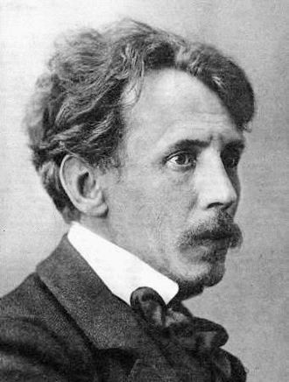
Mikalojus Konstantinas Čiurlionis
Mikalojus Konstantinas Čiurlionis was a Lithuanian painter, composer and writer. He has been considered one of the pioneers of abstract art in Europe. His works have had a profound influence on modern Lithuanian culture.
M. K. Čiurlionis (1875-1911).

Slide 3
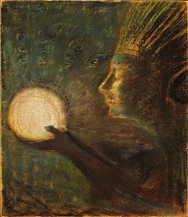
During his short life he composed:
* about 400 pieces of music,
*created about 300 paintings,
*as well as many literary works and poems.
In the background picture“The Gift of Friendship” 1906

Slide 4
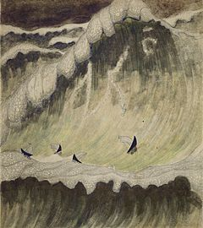
In almost 400 music compositions major part of which are works for piano, but also significant opuses for symphony orchestra (symphonic poems In the Forest and The Sea, overture, cantata for choir and orchestra), string quartet, works for various choirs (original compositions and Lithuanian folk song arrangements), as well as works for organ.
In the background picture “Sonata of the Sea. Finale” (1908)

Slide 5
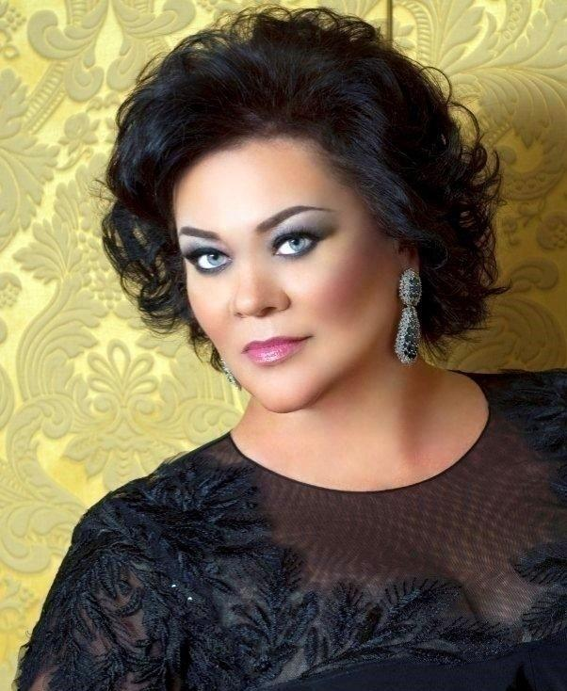
Violeta Urmanavičiūtė - Urmana
Urmana is a Lithuanian opera singer who has sung leading mezzo-soprano and soprano roles in the opera houses of Europe and North America.
Urmana (born January 1st 1961).

Slide 6
Urmana originally sang mezzo-soprano roles but from 2001 began singing dramatic soprano roles.
She sang:
*Madeleine di Coigny in Andrea Chénier at the Vienna State Opera in 2003,
*Isolde in Tristan und Isolde in Rome in 2004 *Leonora in La forza del destino in London that same year.

Slide 7
Awards:
2001 Woman of the Year (Lithuania)
2001 Female Singer of the Year (Lithuania)
2001 National Prize of the Republic of Lithuania for the Arts (Lithuania)
2002 Premio Franco Abbiati (it) Italy
2002 L'Opera Award Italy
2002 Royal Philharmonic Society Music Award (Great Britain)
2007 Honorary citizenship of Violeta Urmana's home town Marijampole (Lithuania)
2007 LT-Tapatybe Award in the arts category for the reputation of Lithuania abroad (Lithuania)
2007 World Intellectual Property Organization Creativity Award
2009 Award of Austrian "Kämmersängerin"
2011 Highest Honour bestowed by the Lithuanian Cultural Ministry
2011 "Shine Your Light and Hope Award" by Carson J. Spencer Foundation (Denver, USA)
2012 Granting of the title of honorary doctor at the Lithuanian Academy of Music and Theatre
2014 Commendatore dell'Ordine della Stella d'Italia
2016 Designated as a UNESCO Artist for Peace

Slide 8
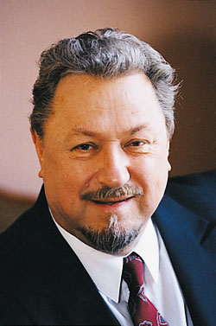
Virgilijus Kęstutis Noreika
Noreika was a Lithuanian tenor.
Noreika has sung in more than 30 foreign theaters, participated in more than 1000 performances, given approximately 600 solo concerts, recorded 20 phonographic records and CDs.
V. K. Noreika (1935-2018)

Slide 9
* Noreika's creative biography comprises more than 40 operatic roles:
*Cavaradossi from Tosca by Puccini
* Faust from Faust by Gounod
* Rudolfo from La bohème by Puccini
* Otello from Otello by Verdi, to name a few.
* Noreika has performed in Moscow at the Bolshoi Theatre, in Buenos Aires at the Teatro Colón, in Paris at the Opéra National de Paris, and many other famous opera houses.

Slide 10
*Noreika, semi-retired, was a professor at the Lithuanian Academy of Music and Theatre and the Estonian Academy of Music and Theatre.
*In 2011, Noreika was awarded the Lithuanian National Prize for Culture and Arts for "the highest vocal excellence and unfading talent".
*In 2015 he was awarded Medal of Pushkin in Russia.

Slide 11
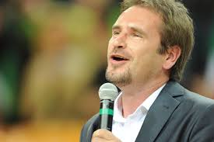
Marijonas Mikutavičius
Marijonas Mikutavičius is a Lithuanian singer, musician and songwriter, a television journalist, a comedian and a talk show host from Vilnius. He is best known for his sports anthem ,,Trys Milijonai’’ as well as an official Eurobasket 2011 song Celebrate Basketball and for representing his country at Eurovision Song Contest 2006 as part of LT United.
Marijonas (born 19 April 1971)

Slide 12
Career:
While studying at the university, Mikutavičius worked for periodicals and as a Vakaro žinios (Evening News) reporter for Lithuanian television. He also played in a rock band Bovy, toured around Europe and sang in the Scandinavian countries, Germany, and Eastern Europe, and gained recognition as the best vocalist at the Liepājas dzintars (Liepāja's amber) music festival in 1995.

Slide 13
Singles and Albums:
Singles:
"Trys Milijonai" (2000)
Often regarded as Lithuanian sport anthem
"Velnias, man patinka Kalėdos" ("Damn, I Like Christmas")
"Pakeliui Namo" ("On Our Way Home")
"Aš miręs" ("I'm Dead")
"Trys Milijonai" ("Three Million"), a hit song; the official song for Lithuania at the Sydney Olympic Games and a popular unofficial Lithuanian sports anthem
"Nebetyli Sirgaliai" (Celebrate Basketball), a hit song; which is extremely catchy; the official basketball anthem for the 2011 Basketball Euro Championships (hosted in Lithuania); represent the nation's faith and passion for Basketball.
Albums:
"Lengvas būdas mesti klausytis" ("Easy Way to Stop Listening") (2014)
"Baigėme mokyklą" ("We Finished School") (2008)
"Pasveikinkit vieni kitus" ("Greet Each Other") (2004)

Slide 14
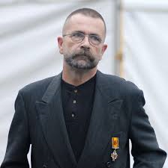
Vytautas Kernagis
Vytautas Kernagis (May 19, 1951 – March 15, 2008) was a Lithuanian singer-songwriter, bard, actor, director, and television announcer. He is considered a pioneer of Lithuanian sung poetry.
Kernagis (1951-2008)

Slide 15
Career:
Vytautas Kernagis was born to the family of actors Aleksandras Kernagis and Gražina Kernagienė. He attended M.K.Čiurlionis school (first 3 years) and Vilnius 23rd school. In 1973 he graduated from the Lithuanian Academy of Music and Theatre.
He was a member of the pioneering Lithuanian big beat bands ,,Aisčiai” (1966–1968) and ,,Rupūs miltai” (1969–1972).
Kernagis recorded his first album of sung poetry in 1978. Kernagis also took part in the first Lithuanian rock opera Devil's Bride, first Lithuanian musical Ugnies medžioklė su varovais (1976), and first Lithuanian musical for a puppet theatre ,,Šokantis ir dainuojantis mergaitės vieversėlis”.

Slide 16
Awards:
1995 - Antanas Šabaniauskas‘s music award,
2000 - "Bravo" music award (LT),
2002 - Officer's Cross of the Order of the Lithuanian Grand Duke Gediminas,
2008 - Lithuanian National Prize for Culture and Arts, for the professionalism in modern creativity and artistry.

Slide 17
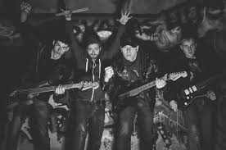
,,Antis”
Literally, "antis" means "duck" in Lithuanian, but is also a music Band. Algirdas Kaušpėdas has stated in an interview that the latter was the intended meaning. Additionally, being a play on the name of the official Soviet-era newspaper "Tiesa" (truth), the name alluded to the biased reporting and truth-bending in Eastern Bloc media. The cover of the band's 1987 album displays the name "Antis" assembled from cut-out letters of Tiesa's logo, with a matching N added. According to Kaušpėdas, contrary to popular belief, "Antis" was not originally intended to stand for "Anti-Soviet". However, upon first hearing the name being interpreted in this way, he found it appropriate and did not object.
Members:
Algirdas Kaušpėdas,
Petras Ubartas,
Vaclovas Augustinas (Keyboards, vocal),
Linas Buda (Drummer)
Gintautas Rakauskas (Bass guitar)

Slide 18
Band’s disbanding and resurrection:
Disbanding
Antis gave their final tours in the second half of 1989 and early 1990 including appearances at festivals in Italy, Austria, Germany, France and USA, where they participated at the NY New Music Seminar and played at the CBGB. In 1990 Algirdas Kaušpėdas quit music for politics and then returned to architecture. The rest of the band continued rehearsing and composing, and auditioned some new vocalists but Pablo proved to have been the heart of the band, so they broke up. Some members left the music business and others joined other projects. Kaušpėdas manages a design company and is still an important figure in Lithuanian music and culture.
Resurrection
After 17 years of silence (the last album having been released in 1990), the band released Ančių dainos (Songs of Ducks) on 16 December 2007. Initial album sales beat the expectations and became best-selling album by Antis. The band played their official farewell concert on July 5, 2016 at Trakai Island Castle, followed by another performance the next day at Raudondvaris Castle, ending the story of Antis where it had begun.

Slide 19
Groups’s albums and discography:
Antis
Anties Dovanėlė
Geriausios Dainos
Ša!
Kažkas Atsitiko
Visa Antis
Antis Gyva
Ančių Dainos
Rugpjūčio 33
Baisiai džiugu
2XDuck!
Zombiai, Atrieda atidunda!

