Slide 1
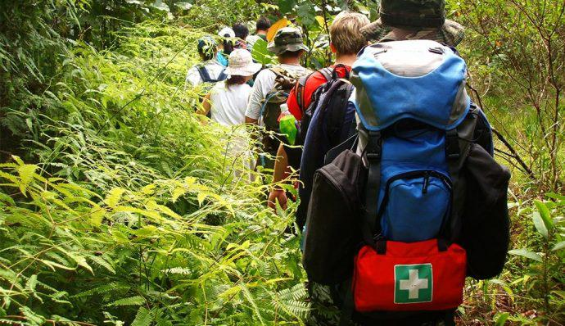
Skin injuries hiking and first aid

Slide 2
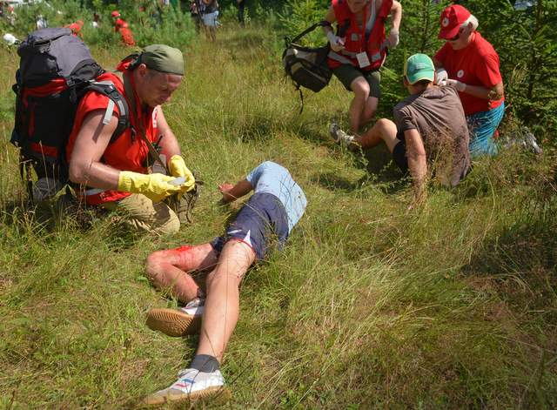
Our purpose today are introduce you with skin injuries hiking and how to give first aid.

Slide 3
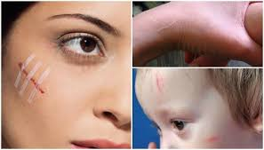
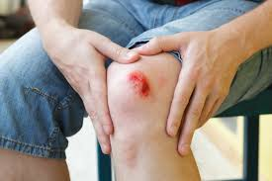
Skin injuries

Slide 4
If you scratch or cut your skin, you have to apply a patch, tissue or clean cloth.

Slide 5
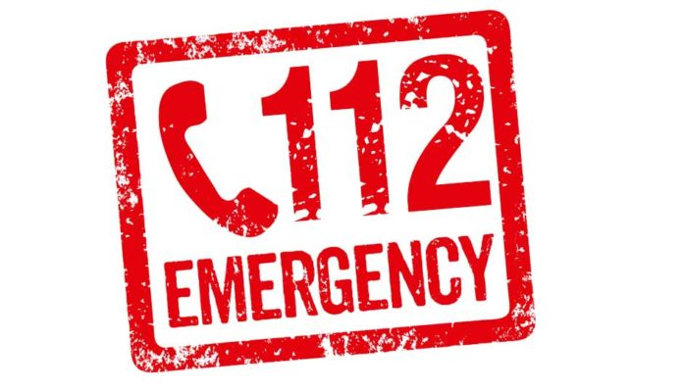
If cut or scratch don’t make danger to your health, you can walk further. But if it’s big lesion, you have to call 112 ant they will take you to the nearest hospital.

Slide 6
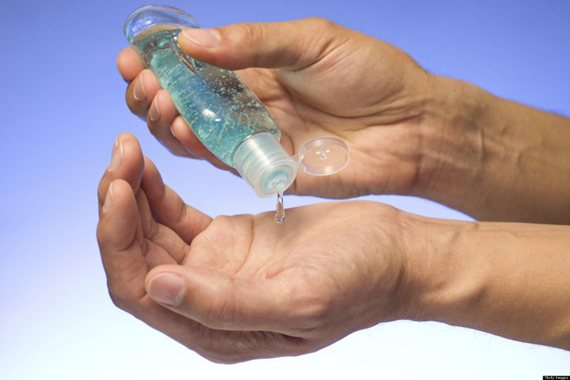
IMPORTANT TO KNOW
Don’t touch injured place with dirty hands, disinfect them because in the wound can arise an infection.

Slide 7
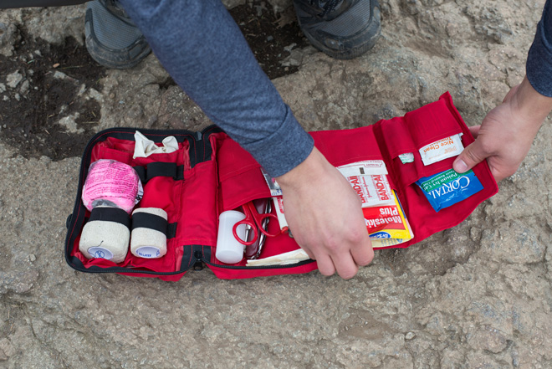
If you’re going on a hike, you need to have first aid kit.

Slide 8
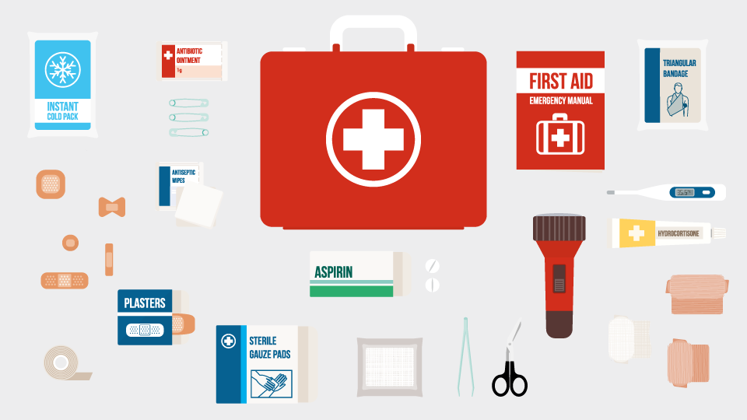
In first aid kit you will need stuff like plasters, scissors, thermometer, bandages, dressing pads and many other things to give a first aid.

