Slide 1

Lithuanian Students Historical,
Cognitive Hiking To Grodno 18.12.2018

Slide 2
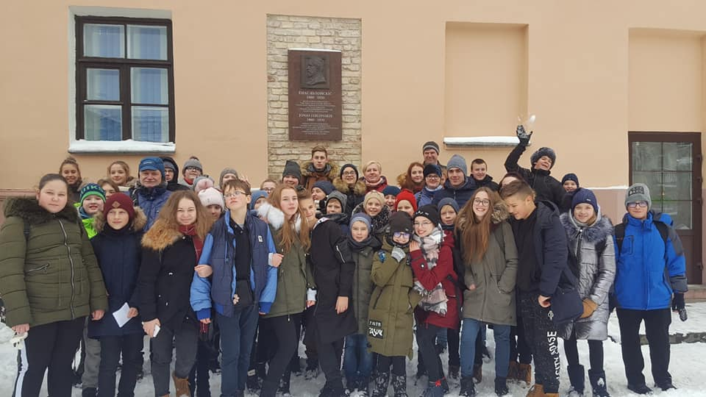
Lithuanian students Historical, Cognitive hiking to Grodno 18.12.2018

Slide 3
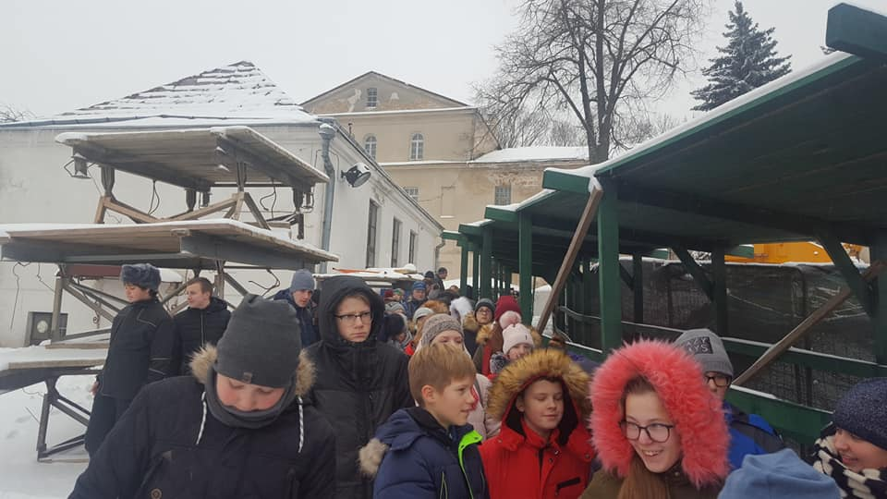

Slide 4
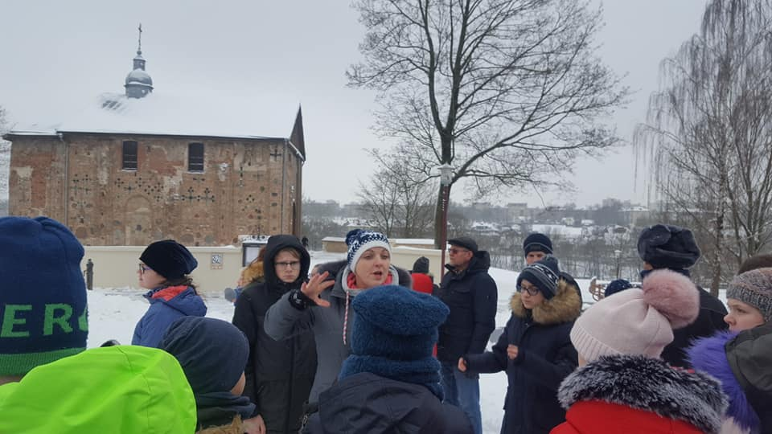

Slide 5
