Slide 1
Literature or poems related to the way in Lithuania

Slide 2
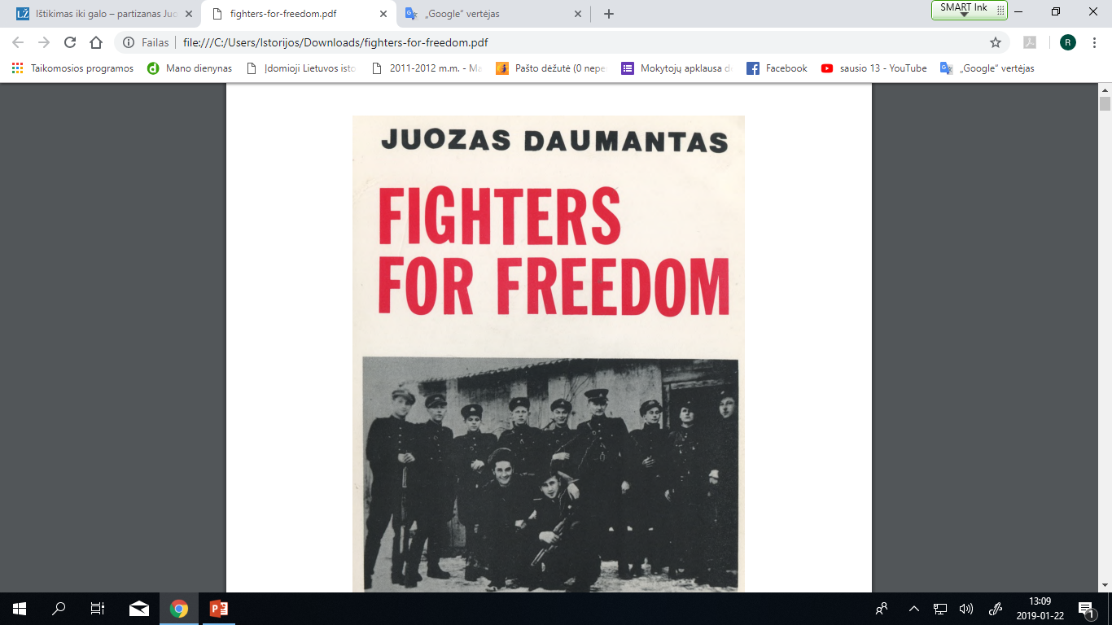

Slide 3
This is a factual, first-hand account of the activities of the armed resistance movement in Lithuania during the first three years of Russian occupation (1944-47)

Slide 4
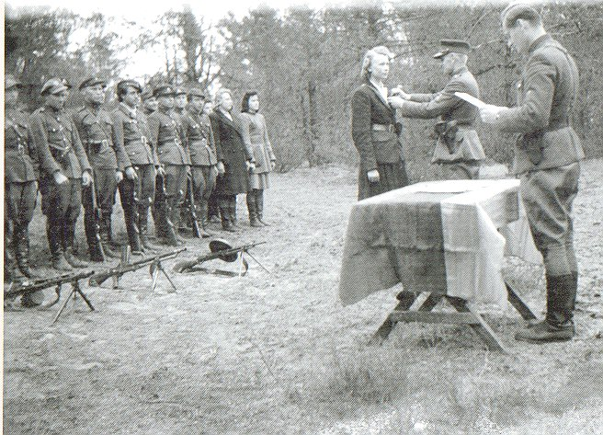
The author, a leading figure in the movement, vividly describes how he and countless other young Lithuanian men and women were forced by relentless Soviet persecutions to abandon their everyday activities and take up arms against their nation’s oppressors.

Slide 5
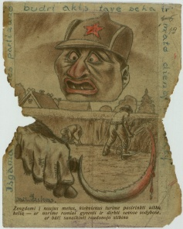
We see them risking their lives to protect Lithuanian farmers against Red Army marauders, publishing underground newspapers to combat the vast Communist propaganda machine, even pitting their meager forces against the dreaded NKVD and MGB.

Slide 6
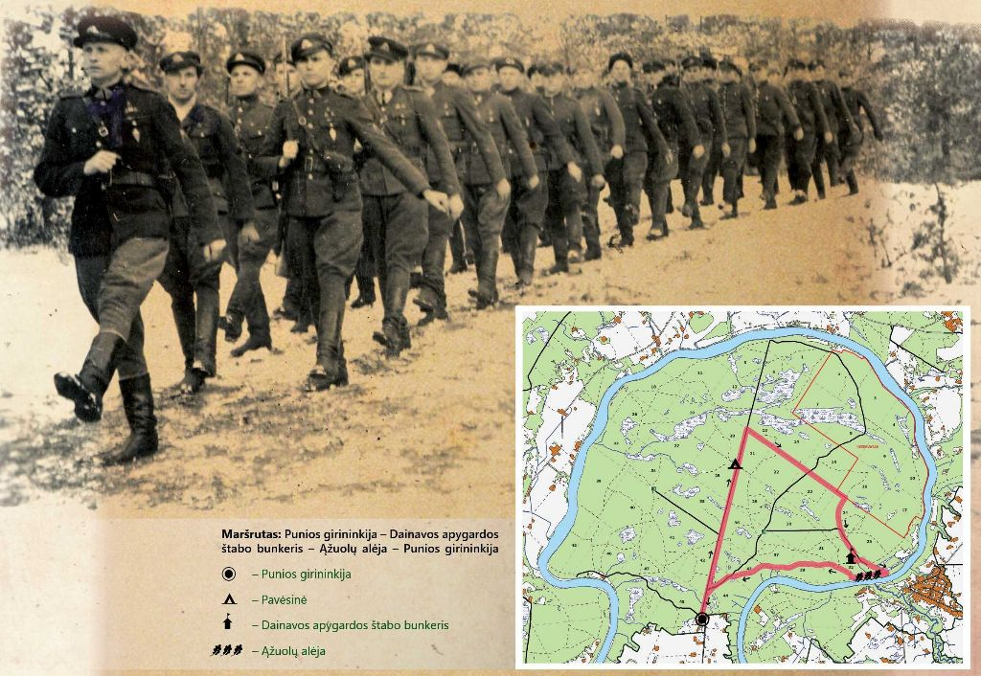
One of the most popular hiking trips in Lithuania is the routs of partisan trails ,,Forest Brothers“.

Slide 7
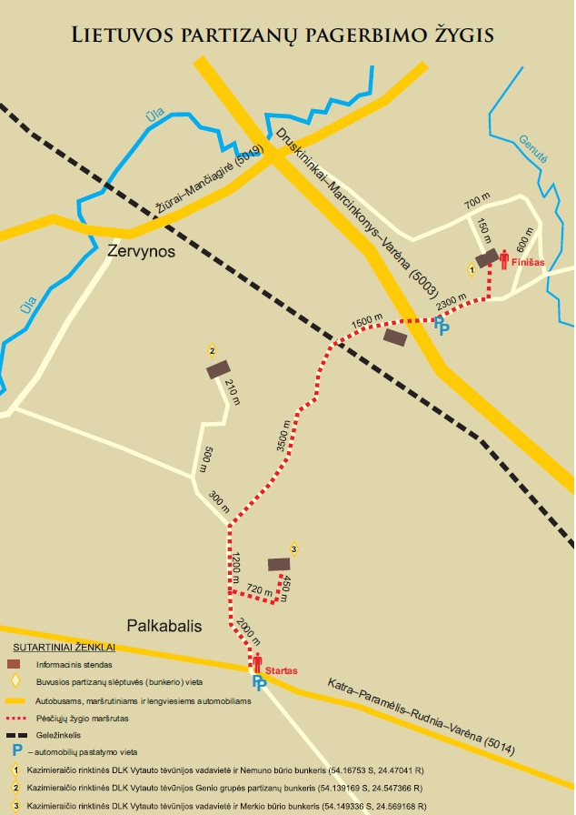
The Lithuanian partisan honoring hike

Slide 8
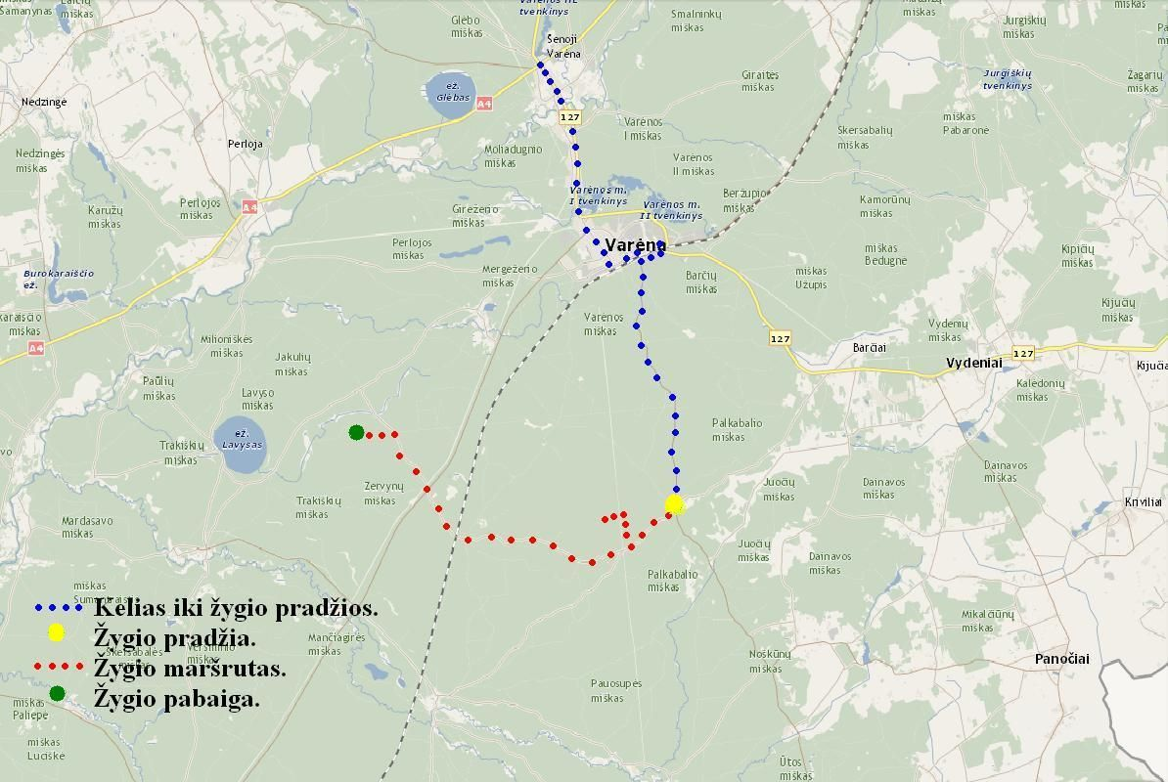

Slide 9
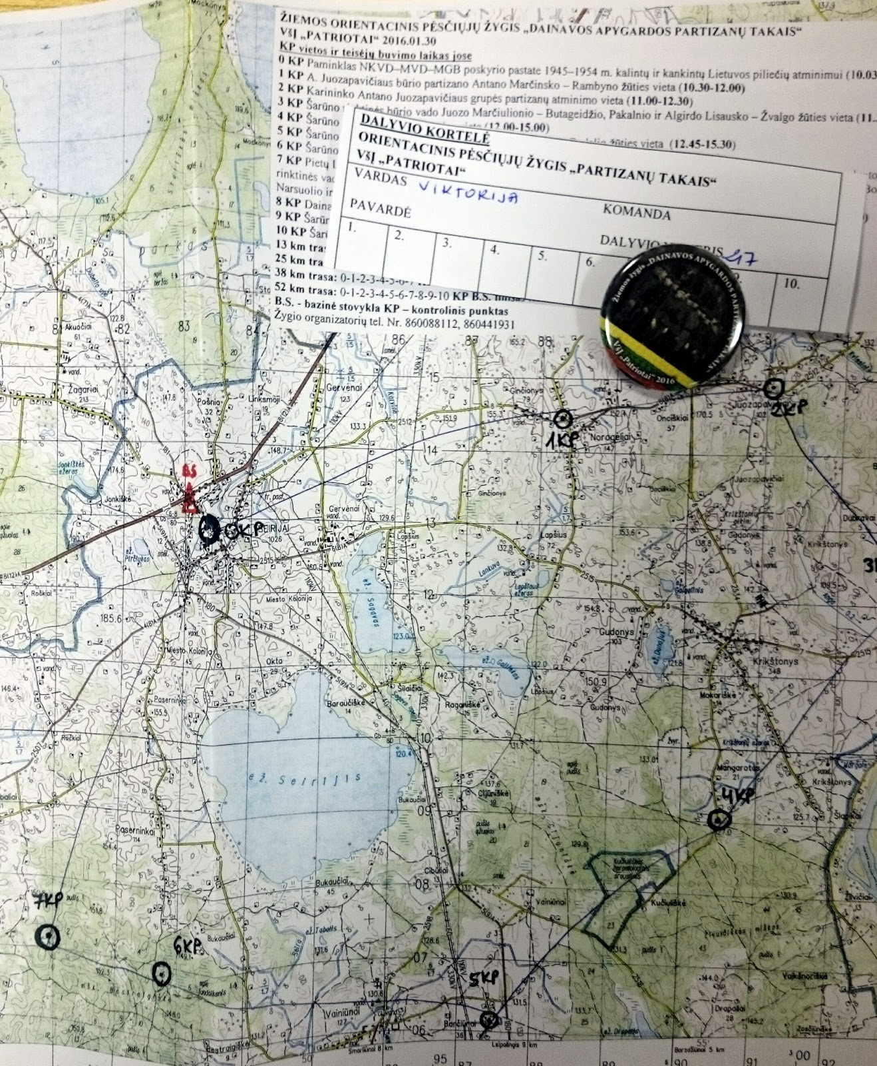

Slide 10
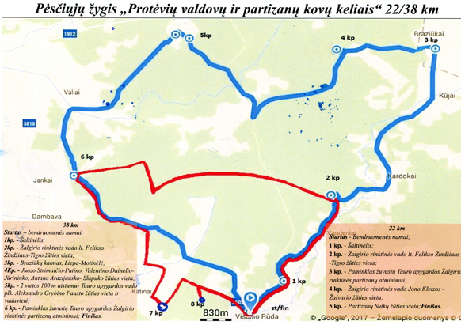

Slide 11
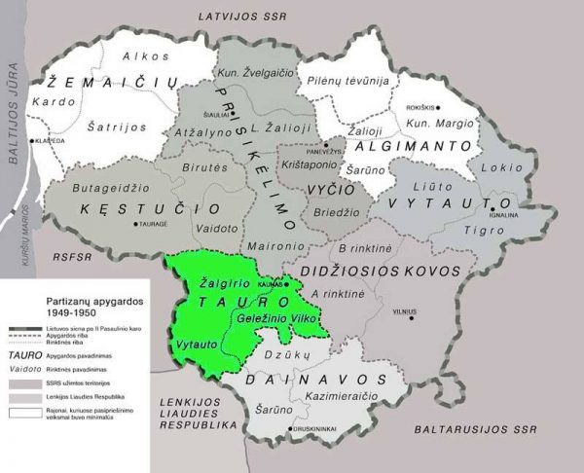
In Partizans territory called Tauras district you have also hiked - partners of the project "Walking the line“, while visiting Lithuaniahttps://www.youtube.com/watch?v=W7F1TMq5Dv4

