Slide 1
Europe’s society in the past and now

Slide 2
In Schengen area you can travel without regular document checking.

Slide 3
The EU guarantees the rights of passengers on trains and airplanes: if your trip is delayed or cancelled, you can immediately demand compensation.

Slide 4
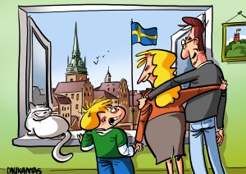
You can freely live in any EU country.

Slide 5
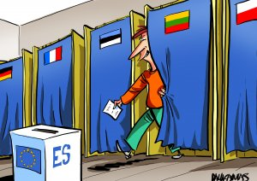
Citizens of the European Union have the right to participate and to be elected in to local government and European parliament.

Slide 6
If you have a vacation in non-EU country and there is no representation of your country you can contact the other EU embassy or consulate.

Slide 7
EU citizens can participate in shaping EU policies by proposing new legislation. Such a citizens 'initiative needs at least one million citizens' signatures from at least 7 EU countries.

Slide 8
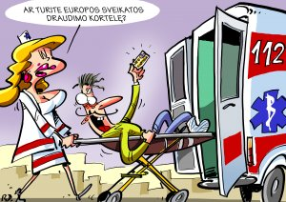
When you are in the other EU country, you have the right to basic medical care.

Slide 9
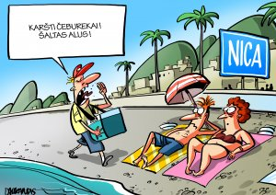
You have the right to work legally in EU country.

Slide 10
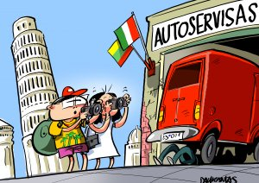
In any EU country, citizens have the right not only to work legally, but also to set up their own business on equal conditions as the local people.

Slide 11
Thanks for your attention!

