Slide 1
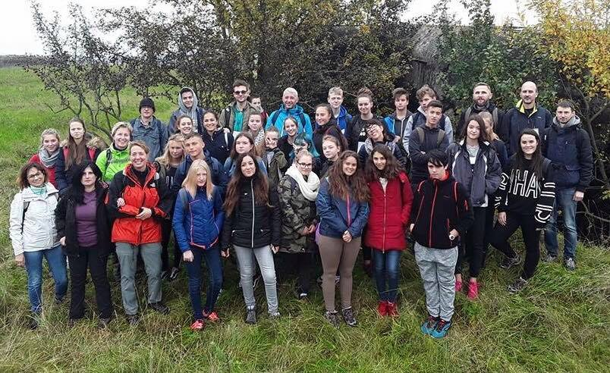
WHO DID THIS ROUTE IN THE PAST?

Slide 2
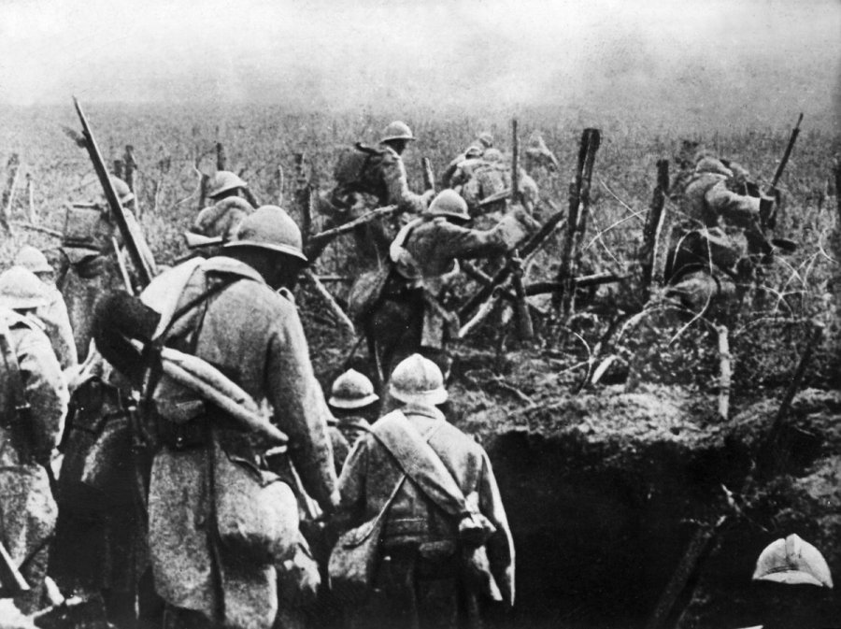
In 1915 Germans army approached next to Kalvarija district and was stopped by Russia army. Battle field took part around the city Kalvarija. Front line was established just few kilometers from city. Trough intensive battles and fights were killed hundreds of Germans.

Slide 3
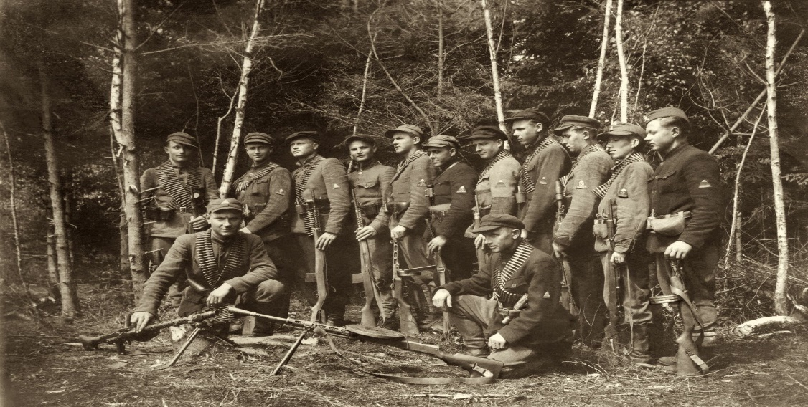
After II World War in 1945, started Lithuanians occupation and treats to local population. A lot of young people decided to start fighting against occupation. Marijampole, Kalvarija district not exception, there were strong resistant of freedom fighters against occupants. They used the same routs with aim to achieve freedom and independence of Lithuania.

Slide 4
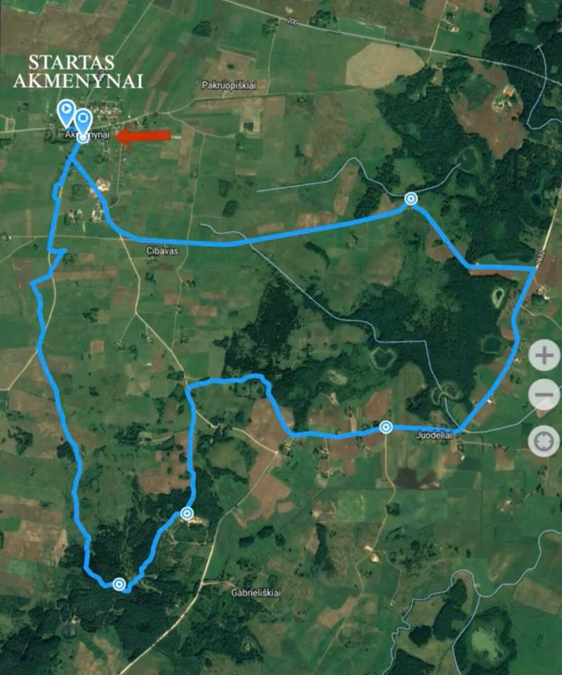
In 2017 autumn we all together, students and teachers from Catalonia(Spain), Romania, Italy, Germany conducted 15 km march following freedom fighters‘ routs which took us 5 hours.

Slide 5
Fighters - the people who sacrificed their own lives for Lithuania freedom.
Tauro partisans‘ county was responsible for freedom fights in Marijampole district.

Slide 6
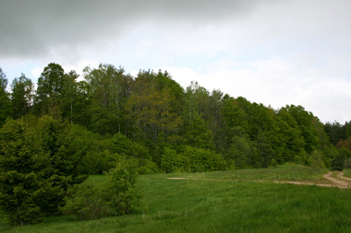
Our march followed in the village of Akmenynai, Kalvarija district. We visited bunkers, Papiliakalnio hillfort, the monument of Lithuanian independence for 10 years anniversary, the battle place – the monument in memory of freedom fighters‘ deaths during the march.

Slide 7
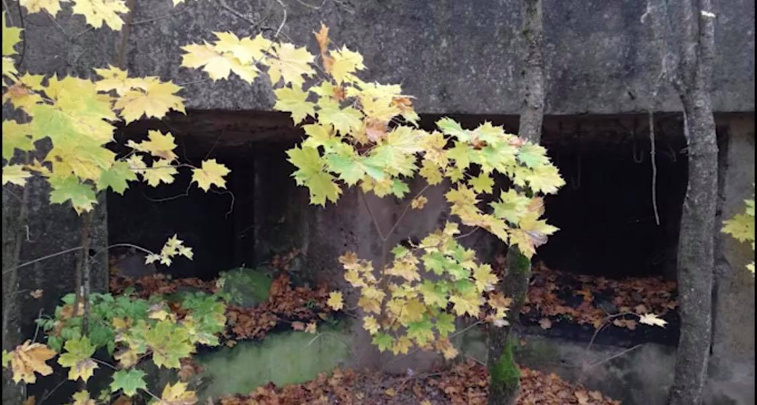
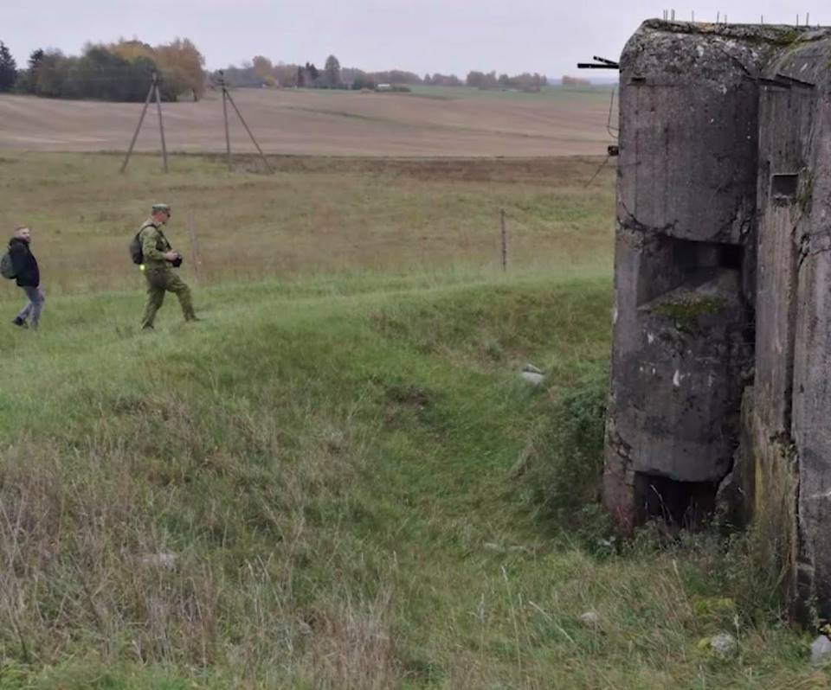
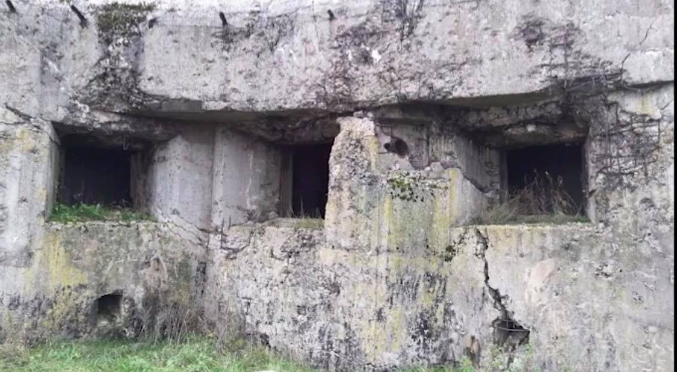
In the march we visited bunkers which were built in the Second World War:
Bunkers – are strong points with the aim to defend and protect the area.

Slide 8
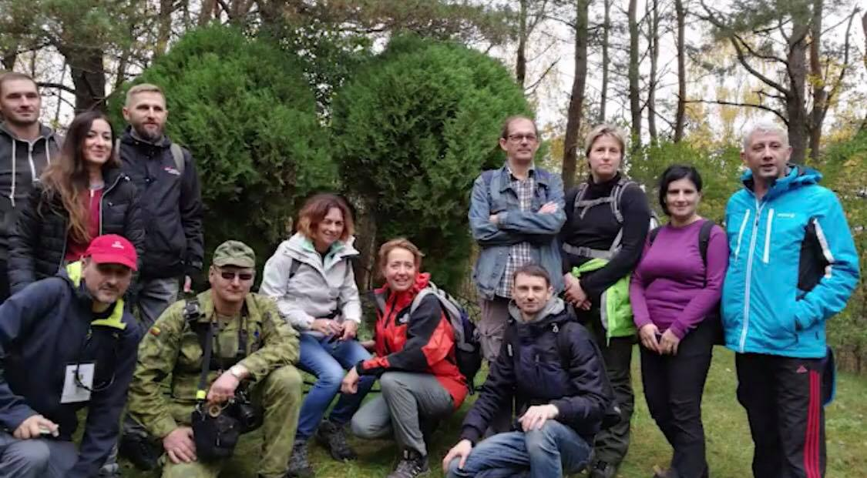
We all together visited the monument of independence which was built in 1928.

Slide 9
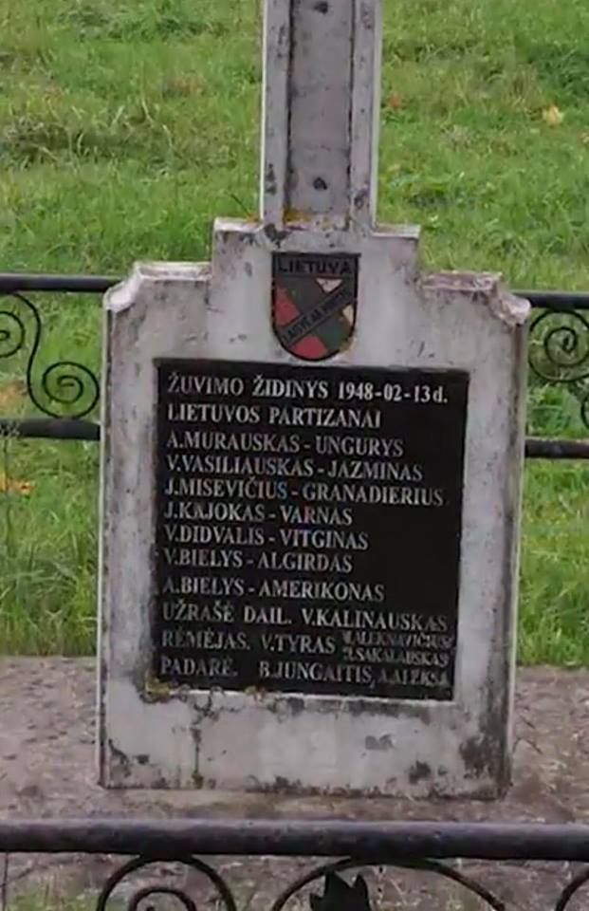
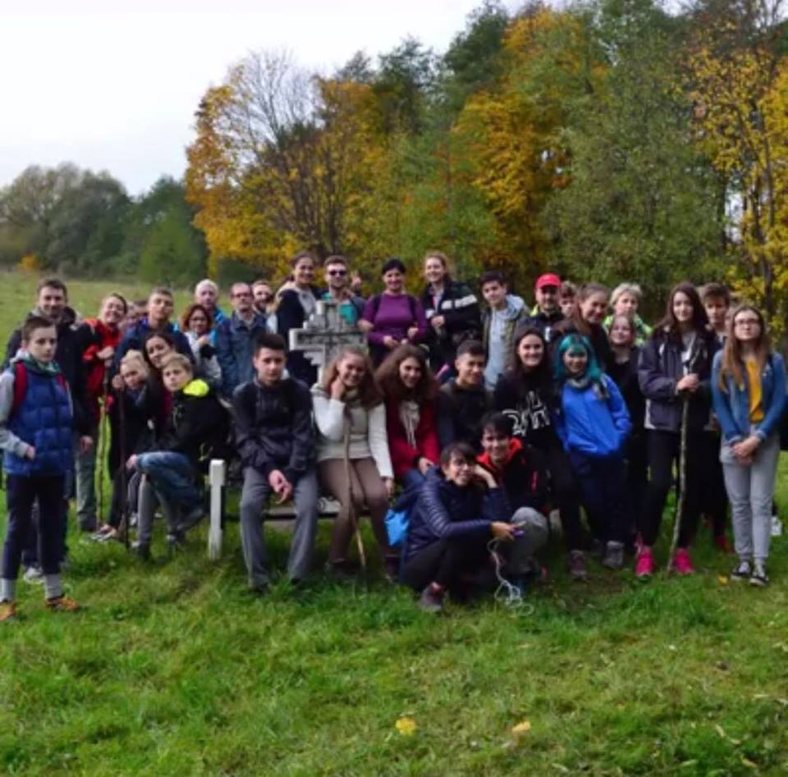
Also we reached the battle place and the monument where were the freedom fighters
were killed.

Slide 10
During all the march we spent a great time. Also we had a chance to get acquainted better with each other.
Besides, we had a possibility to see wonderful Lithuania's nature and to know more about our country history. You can see about our hike
https://www.youtube.com/watch?v=W7F1TMq5Dv4

Slide 11
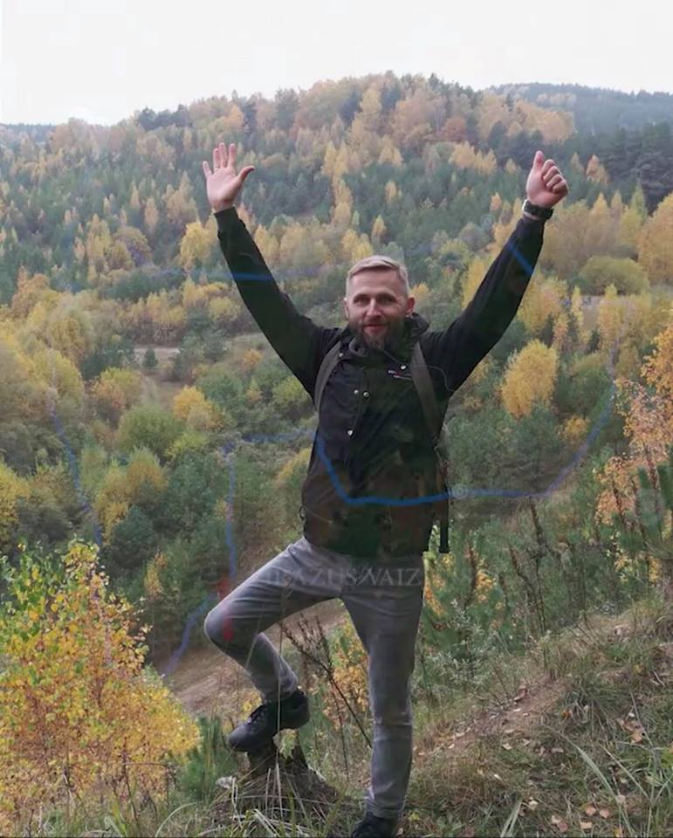
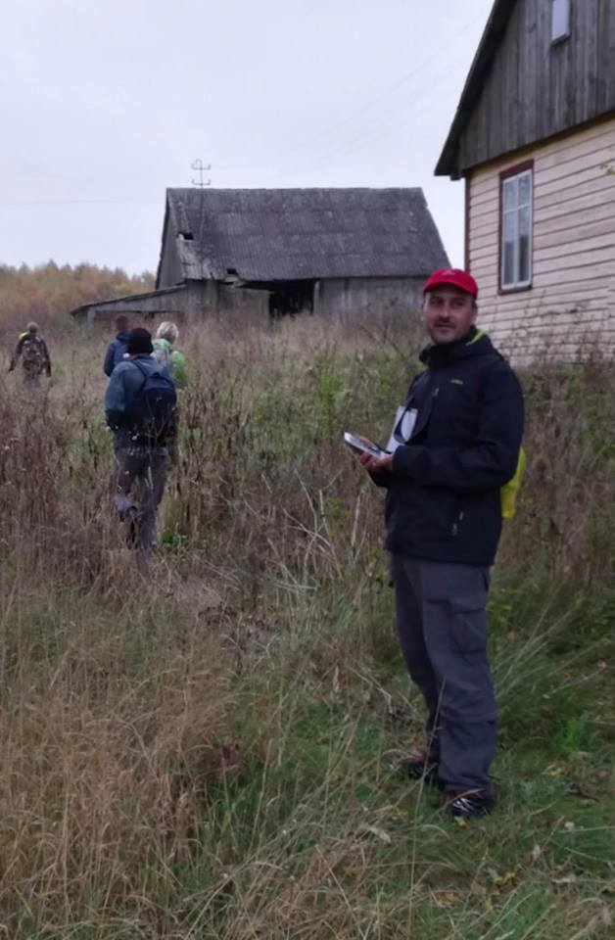

Slide 12
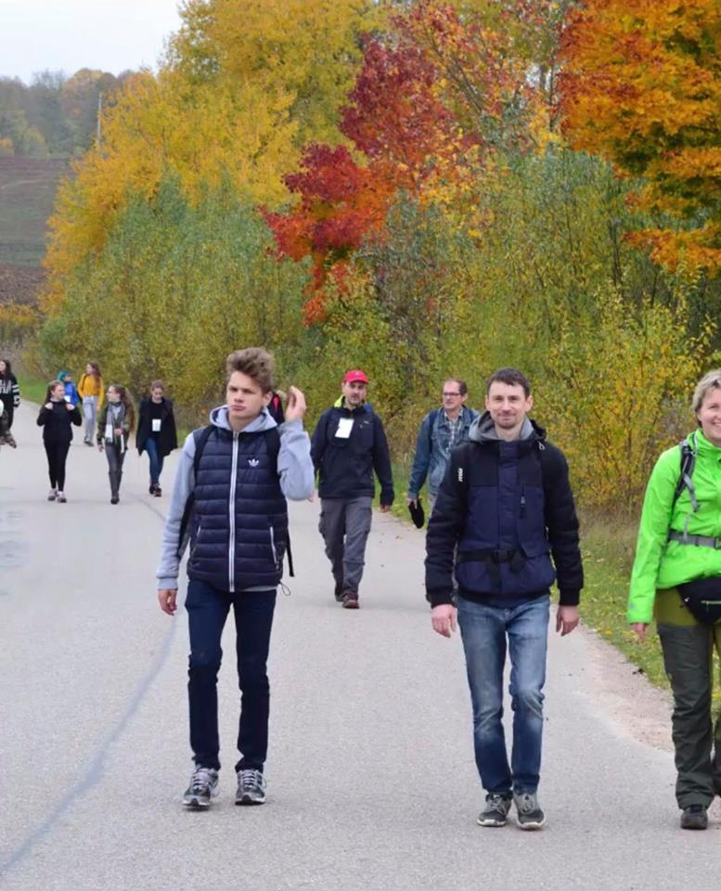
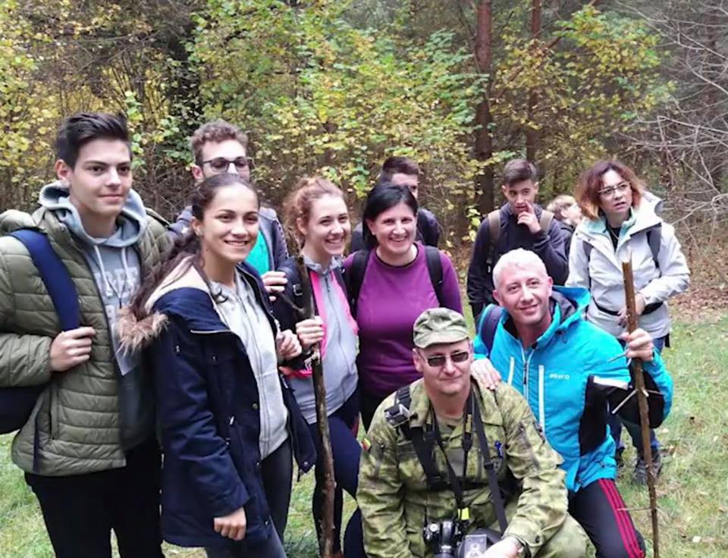
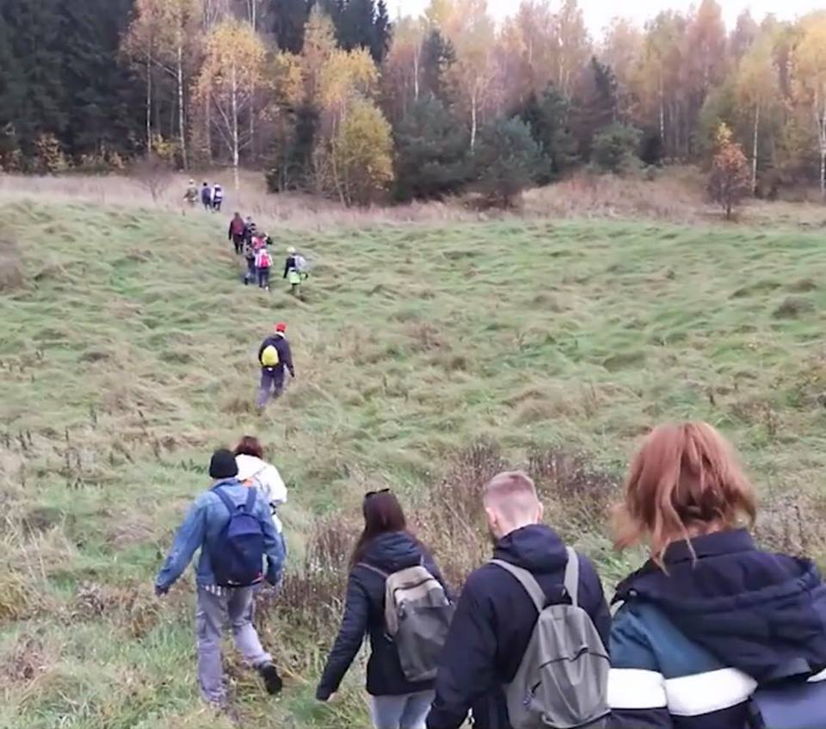

Slide 13
Thanks for attention

