Slide 1
signs of lithuanian hiking trails

Slide 2
This sign means that pesticides are prohibited

Slide 3
This sign allows you to go

Slide 4
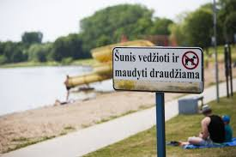
Not allowed to walk dogs

Slide 5
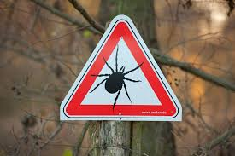
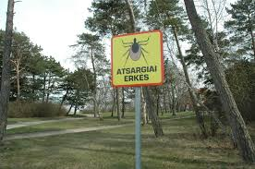
Carefully. Mites

Slide 6
Frogs reserve

Slide 7
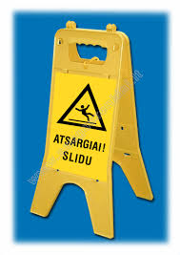
Warning! Slippy

