Slide 1
Traditional activities in Lithuania

Slide 2
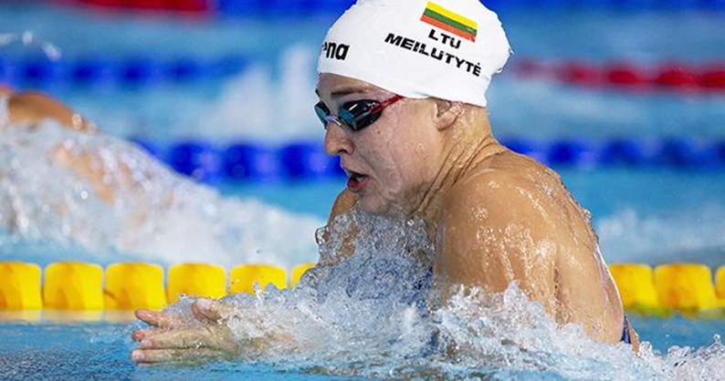
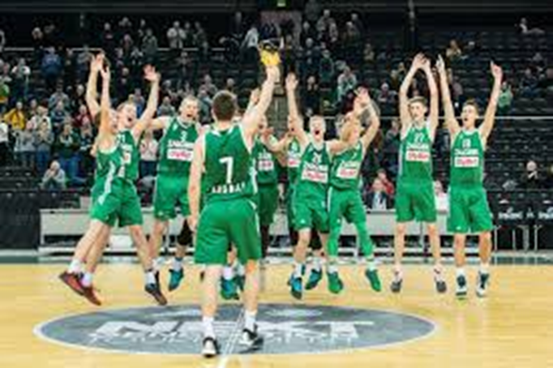
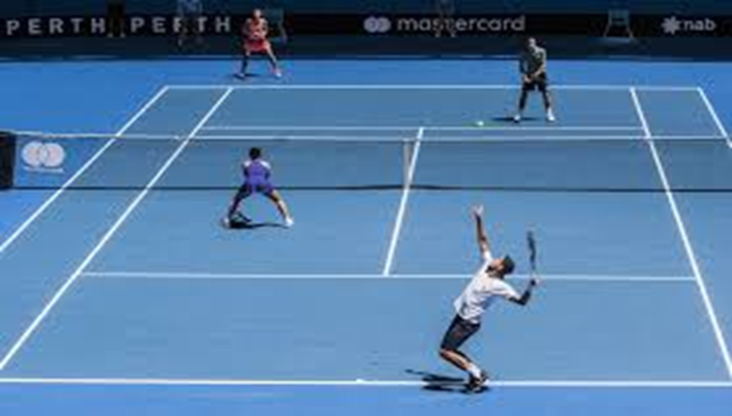
Popular sports in Lithuania

Slide 3
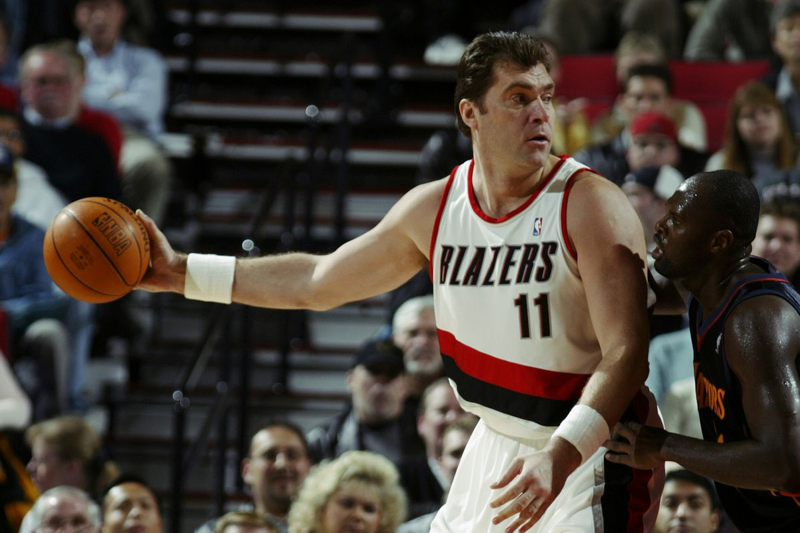
Basketball
Basketball is the most popular sport in Lithuania. Every Lithuanian watches team competitions and supports them. And of course every little boy in Lithuania wants to be like a legend of team – Arvydas Sabonis.

Slide 4
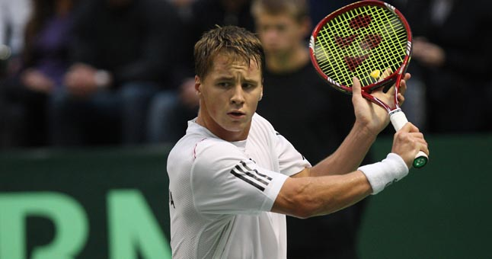
Tennis
Tennis is one of the most popular sports in Lithuania too. We have a good players which brings us a good prizes from contests. For example Ričardas Berankis, the first Lithuanian tennis player, entering into the ATP top hundred first grade, currently ranks 107 th place. He became world champion to 14 years age group and won in 2007.

Slide 5
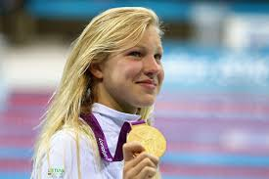
Swimming
Swimming is popular sport in Lithuania too. Swimming is a very good for our health and muscles so thats why 2nd graders are going there to practice swimming with their teachers. And also we have swimmers who are known for them achievements. For example Rūta Meilutytė multiple national women's swimming record-holder, world and European record holder. Olympic, world and European champion. Triple-Lithuanian athlete.

Slide 6
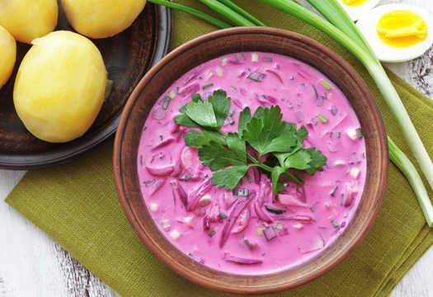
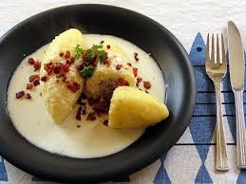
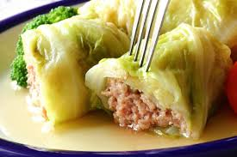
Traditional food in lithuania

Slide 7
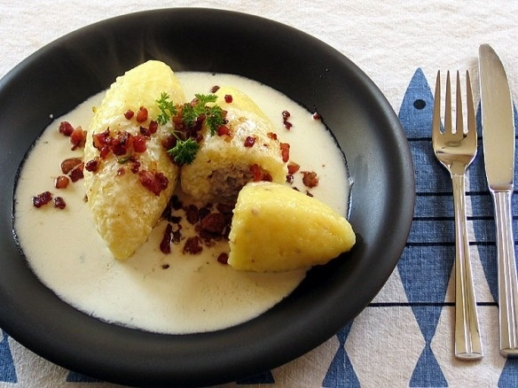
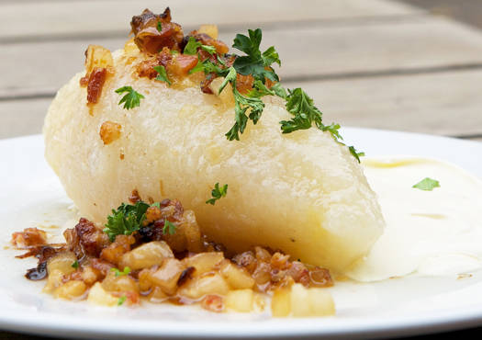
Cepelinai
Cepelinai is one of the most popular traditional dish in Lithuania. Every grandmother must make it for her grandchildrens, it‘s like tradition from generation to generation.Cepelinai are made from grated potatoes and meat. They also come with sour cream and bacon bits.

Slide 8
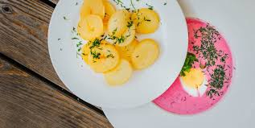
Šaltibarščiai
Šaltibarščiai is Lithuanians traditional summer dish. And it‘s also very easy to make. You only need kefir, beets, cucumbers and put everything into one bowl. They are provided with hot potatoes.

Slide 9
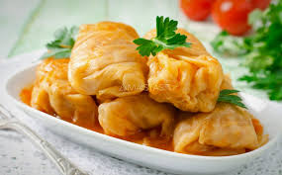
Balandėliai
Balandėliai are also given from generation to generation. To make them it‘s a little bit harder, but still very tasty. Made balandėliai you need to screw mince cabbage leaves with rice and put to boil. Balandėliai are provided with hot potatoes too.

Slide 10
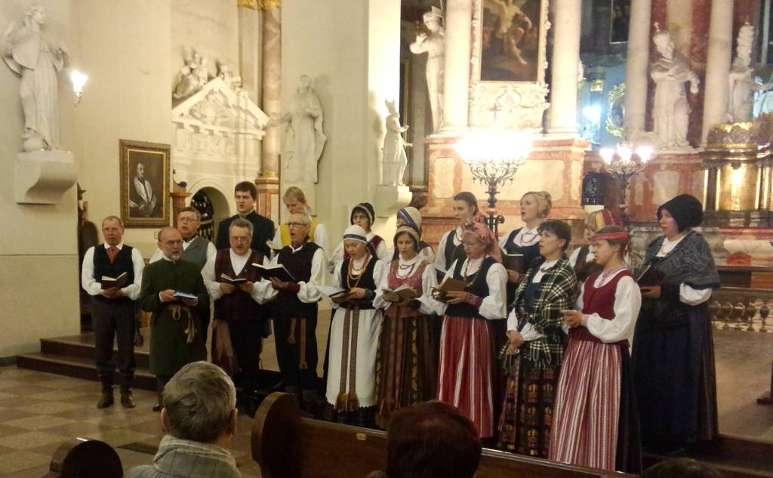
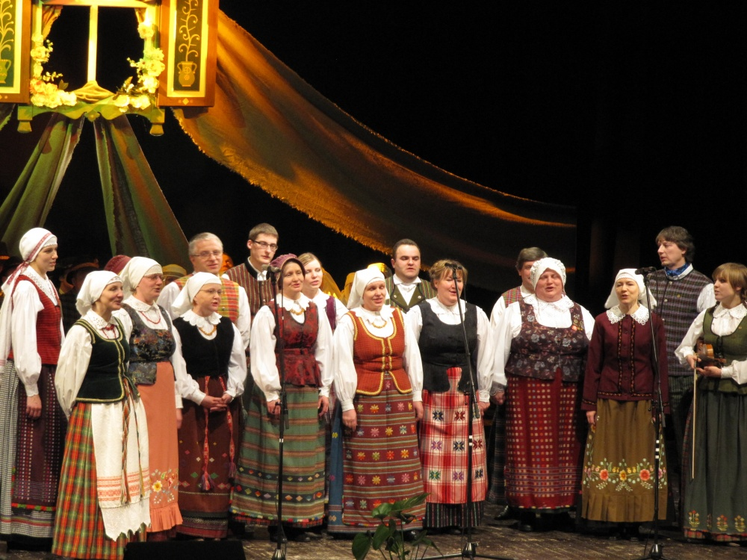
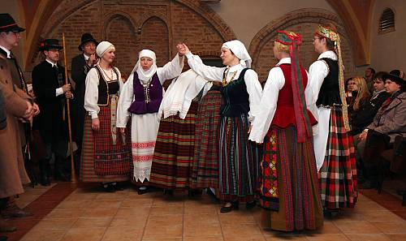
Traditional music in Lithuania

Slide 11
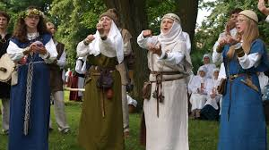
Contractual music
Contractual music is a form of polyphonic music performed by female singers in north-east Lithuania. The songs have simple melodies, with two to five pitches, and comprise two distinct parts: a meaningful main text and a refrain that may include nonce words.

Slide 12
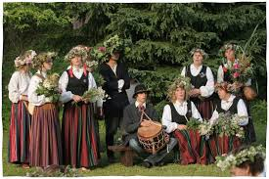
Folk music
Folk is the whole of the nations. These are the folk songs, laments, tales, legends, myths, interrogative riddles, proverbs, sayings, games, Sorcery spells and formulas ty.

Slide 13
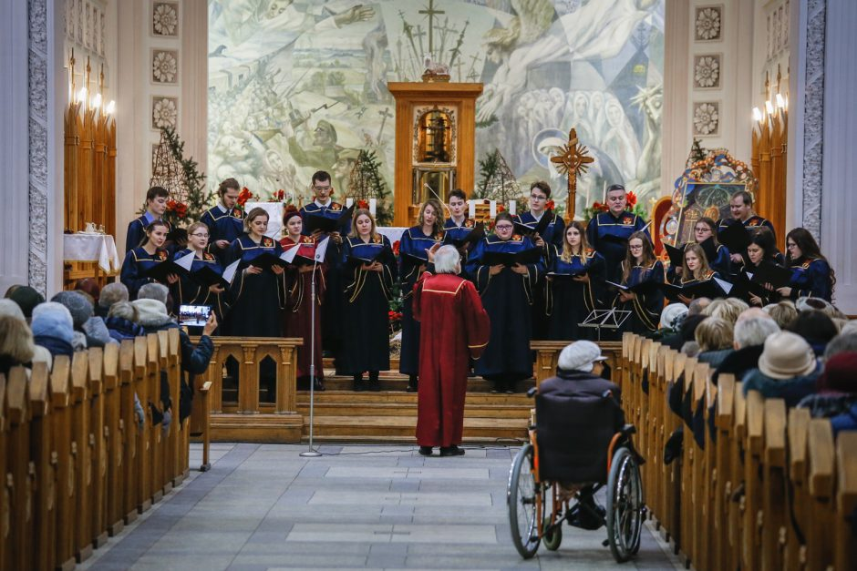
Songs
Song is the Christian origins and in comparison with other genres, very young. Most of the songs appeared in Christian texts in combination with folk melodies. But some songs are syncretic nature, it has old religious elements.

