Slide 1
2018-2019 Erasmus+ “Walking the line”
Famous athletes of Lithuania

Slide 2
Sport in Lithuania
Among the most popular sports in Lithuania are basketball, football, athletics and cycling.
Basketball is the most popular and successful team sport in Lithuania. It’s like a second religion to us. We are really proud of our national team.
Athletics are imortant too. Cycling, diskus throwing, swimming. All of these have made us known.

Slide 3
So let’s meet the famous athetes of Lithuania.

Slide 4
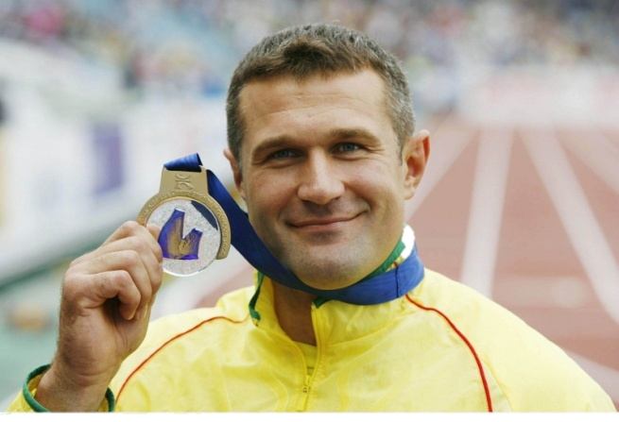
Virgilijus Alekna

Slide 5
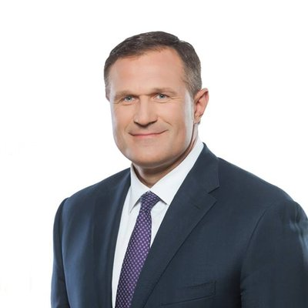
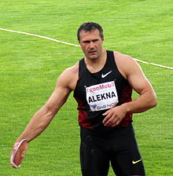
Virgilijus Alekna
Lithuanian former discus thrower and politician. He won medals at the Olympics, including two golds. After retiring from athletics, Alekna was elected to the national parliament. Alekna was awarded the title of the Athlete of the Year for 2000 by Track and Field News. He was also awarded the Order of the Lithuanian Grand Duke Gediminas by the government of Lithuania. He became the Lithuanian Sportsman of the Year 4 times.

Slide 6
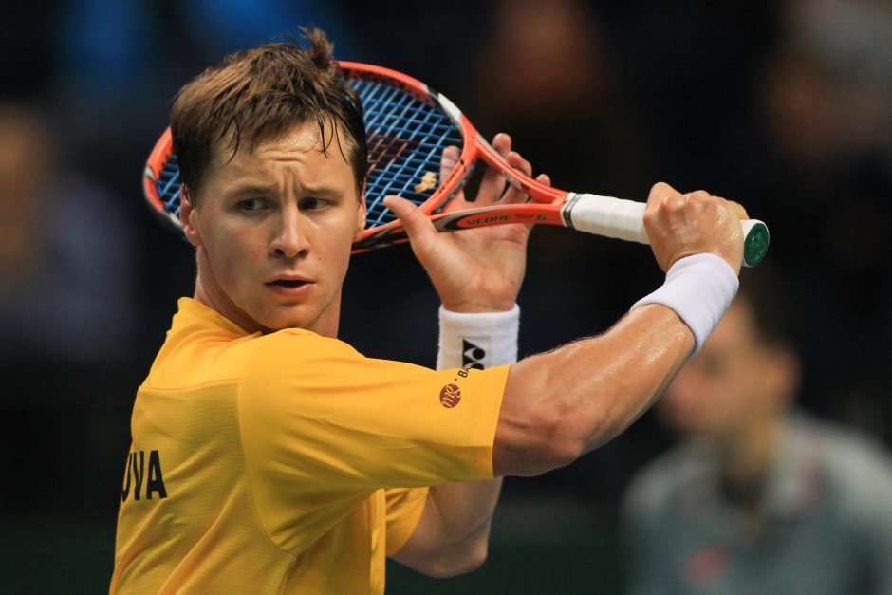
Ričardas Berankis

Slide 7
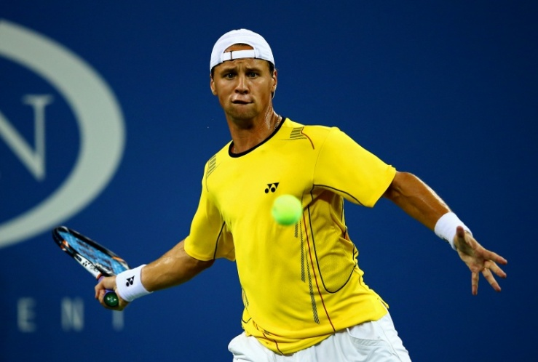
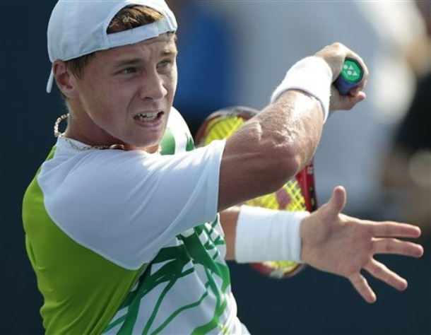
Ričardas Berankis
Lithuanian professional tennis player. He is the first and only Lithuanian to enter the ATP top 100 making him the highest ranked Lithuanian tennis player of all time. Berankis started playing tennis at the age of two, when his six years older sister Lina took him to her tennis practices.He still plays tennis and he is 28 years old.

Slide 8
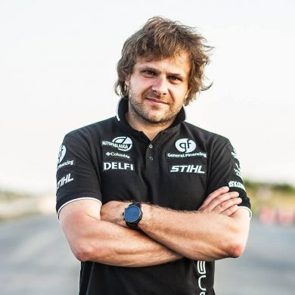
Benediktas Vanagas

Slide 9
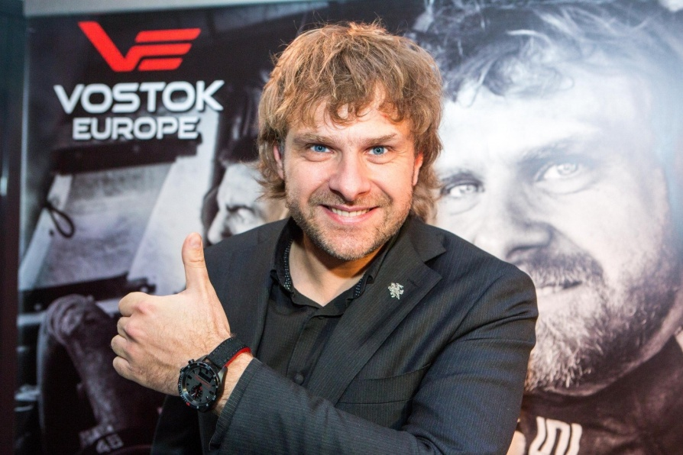
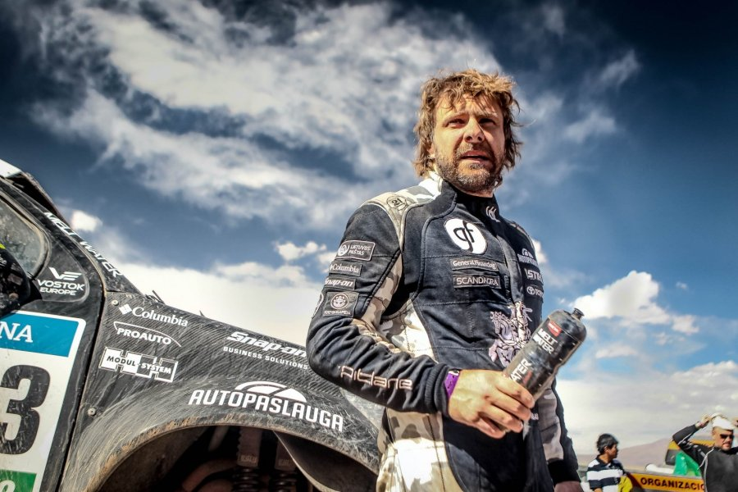
Benediktas Vanagas
Lithuanian rally driver. Vanagas is one of the few car racers in the Baltic states who has achieved strong results in rallying, cross country racing, and off-road competitions, though he most often competed as a rally driver. He is a member of the General Financing team.

Slide 10
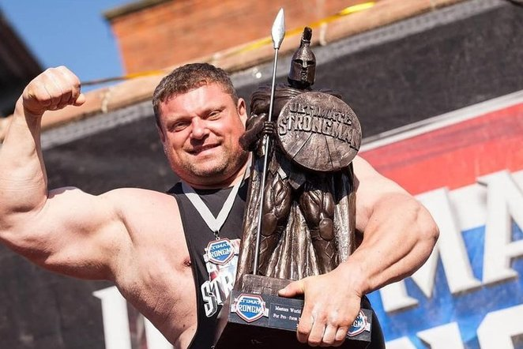
Žydrūnas Savickas

Slide 11
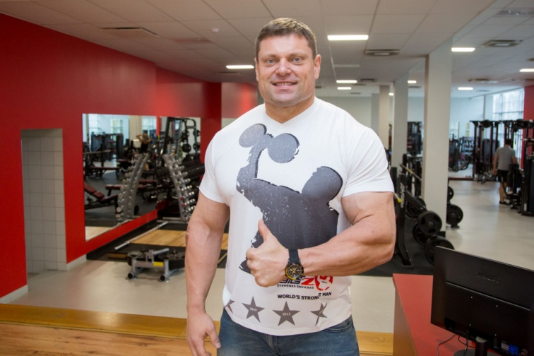
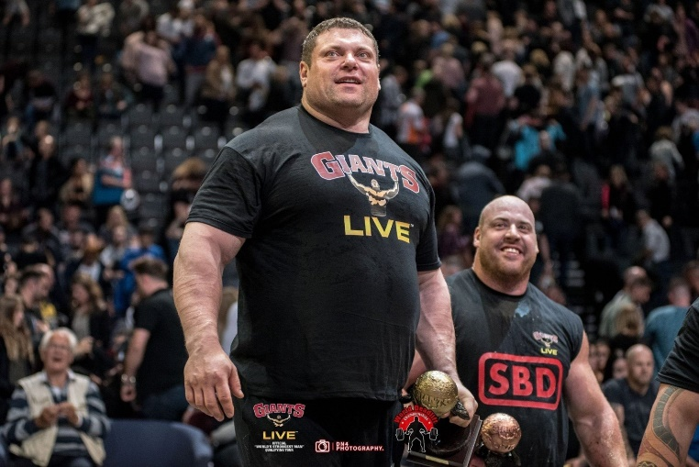
Žydrūnas Savickas
Lithuanian powerlifter and professional strongman. He is considered one of the greatest strongman of all time, and is the only modern competitor to have won every current major strongman competition. At age 17, Savickas began to train in powerlifting. In his second powerlifting contest, he broke all the Lithuanian records.

Slide 12
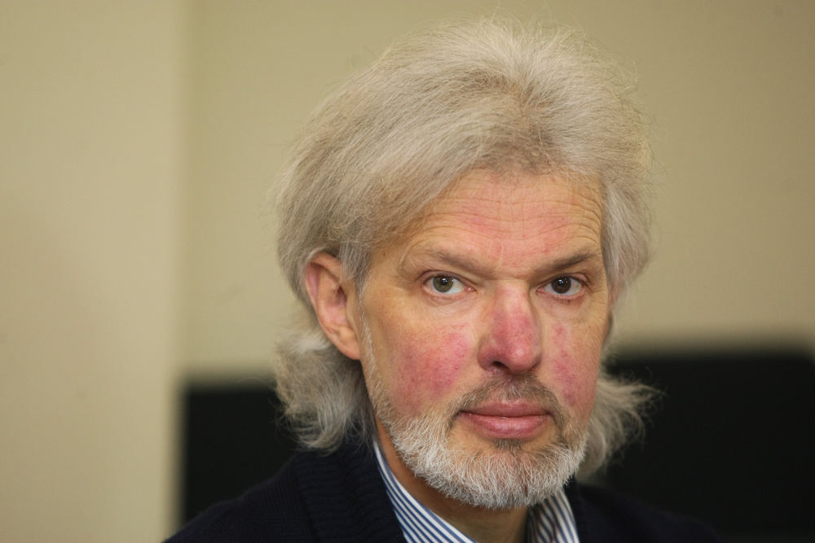
Vladas Vitkauskas

Slide 13
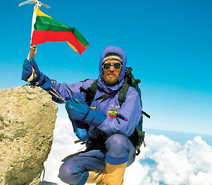
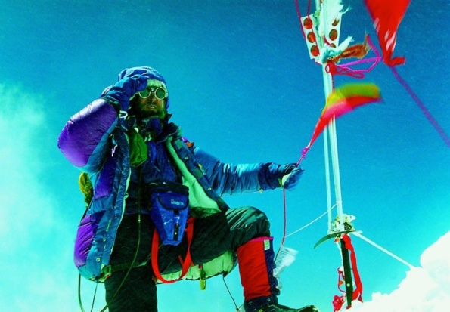
Vladas Vitkauskas
First Lithuanian and the first mountaineer from the Baltic states to climb the world‘s highest mountain, Everest. itkauskas gives many seminars and lectures, arranges meetings with the public. He also gives lectures at business management courses at Lithuanian and foreign companies. He arranges and promotes cultural and health and natural lifestyles events.

Slide 14
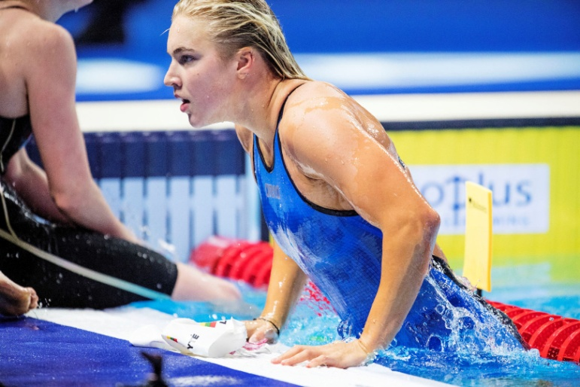
Rūta Meilutytė

Slide 15
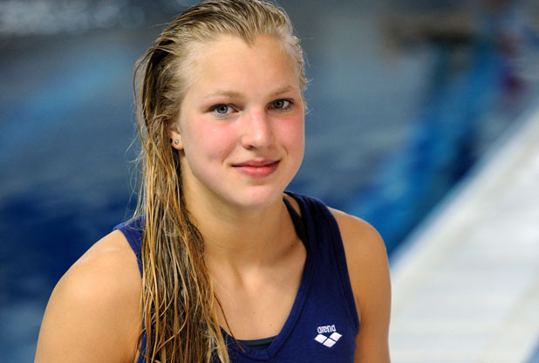
Rūta Meilutytė
Lithuanian swimmer, Olympic gold medalist, and world record-holder. She is the current world record holder in the 100 metre breaststroke. At age 15, she was also the youngest Lithuanian athlete to win an Olympic gold medal. At the age of 17 she became the first and the only swimmer in history to win all available junior and senior international swimming championships.

Slide 16
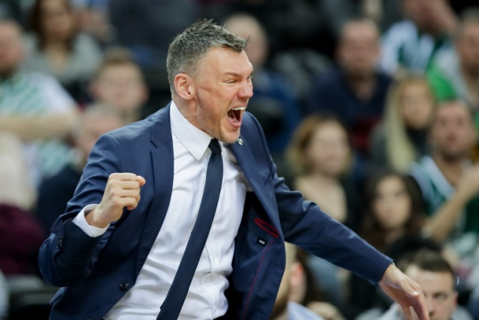
Šarūnas Jasikevičius

Slide 17
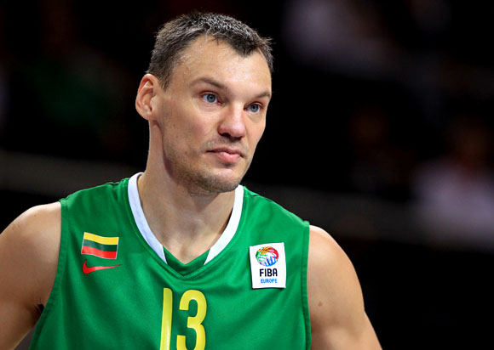
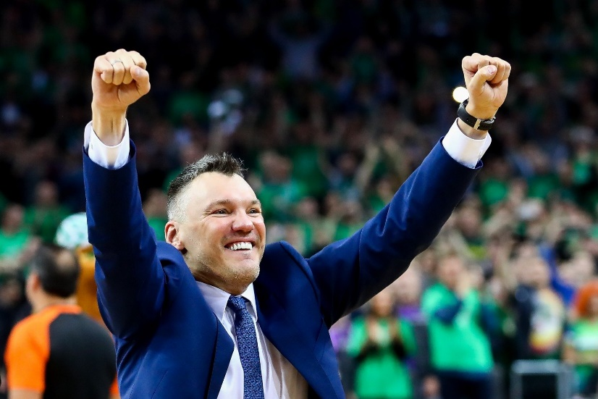
Šarūnas Jasikevičius
Lithuanian professional basketball coach and former professional player. He currently serves as the head coach for Žalgiris of the Lithuanian Basketball League. he is the only player in EuroLeague history to win the competition with three different clubs. Jasikevičius was named a EuroLeague Basketball Legend, as a reward for his stunning playing career,

Slide 18
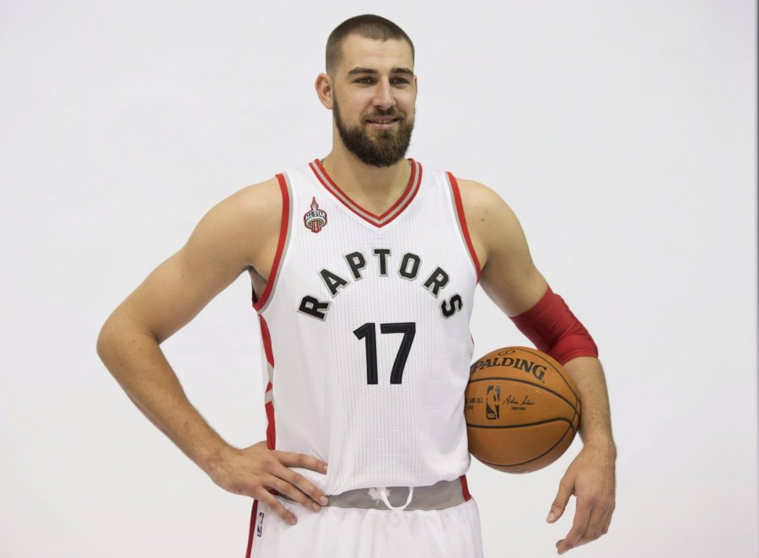
Jonas Valančiūnas

Slide 19
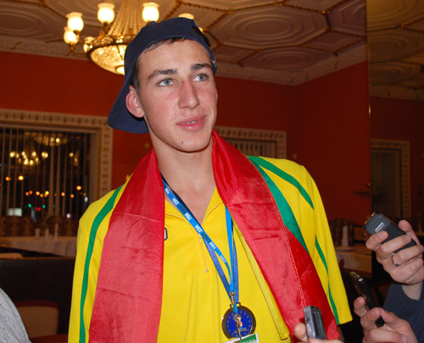
Jonas Valančiūnas
Lithuanian professional basketball player for the Toronto Raptors of the NBA. Valančiūnas has been a member of the Lithuania men's national basketball team since age 19. Valančiūnas also appeared in the documentary The Other Dream Team.

Slide 20
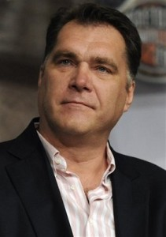
Arvydas Sabonis

Slide 21
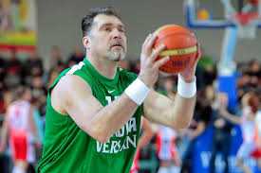
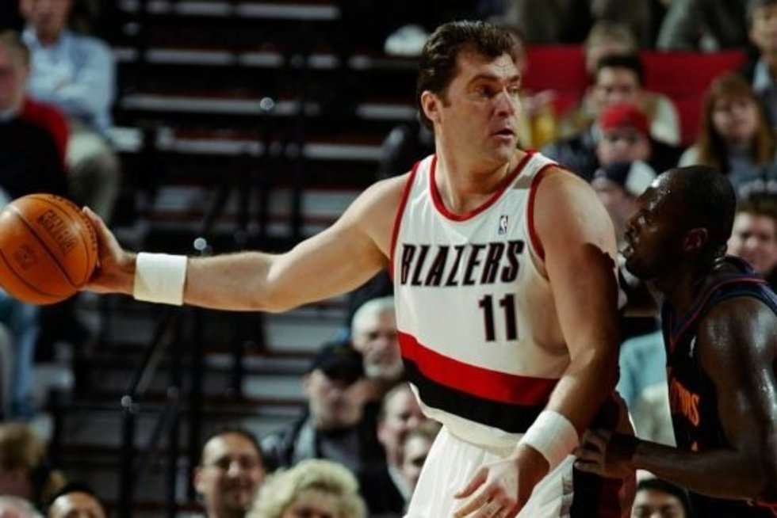
Arvydas Sabonis
Lithuanian retired professional basketball player. Recognized as one of the best European players of all time. He played in a variety of leagues, and spent seven seasons in NBA. Sabonis is considered one of the best big man passers, as well as one of the best overall centers, in the history of the game.

Slide 22
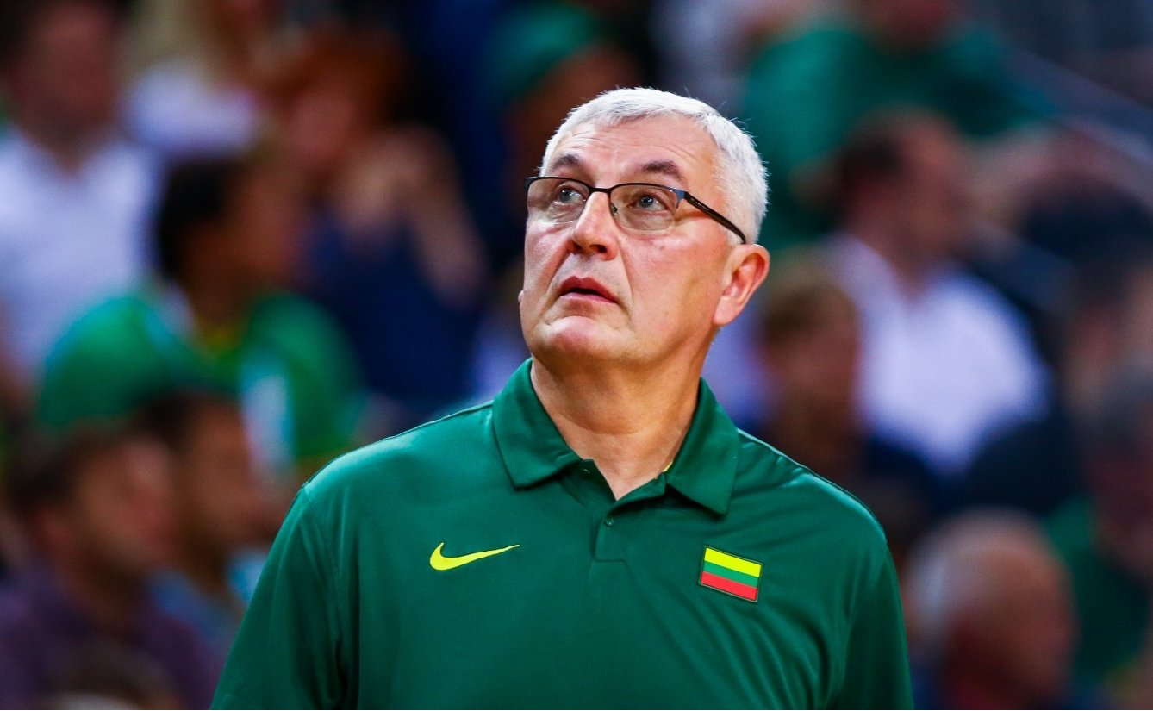
Jonas Kazlauskas

Slide 23
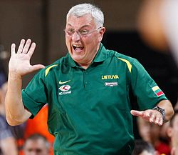
Jonas Kazlauskas
Lithuanian professional basketball coach and former player. Kazlauskas is considered to be one of the best coaches in Europe. In the past, he has coached Lithuania's top two pro club basketball teams.

Slide 24
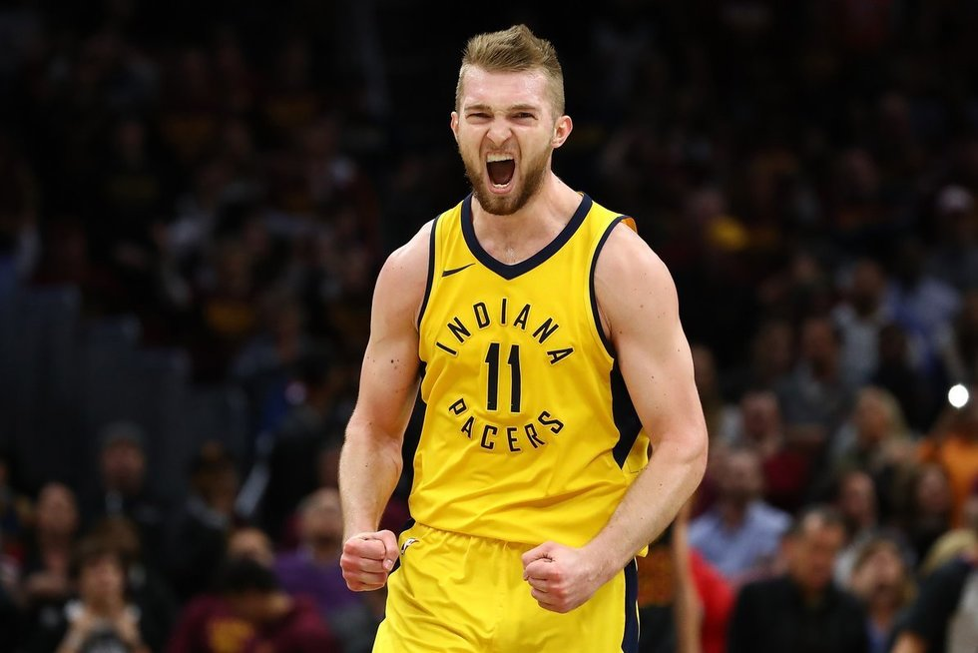
Domantas Sabonis

Slide 25
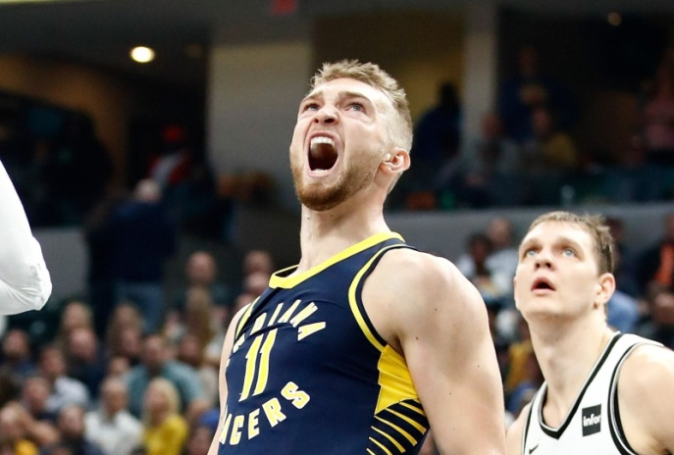
Domantas Sabonis
Lithuanian professional basketball player for the Indiana Pacers of the NBA. He is the son of the Basketball Hall of Famer Arvydas Sabonis, and was born in Portland, while his father was playing for the Portland Trail Blazers.

Slide 26
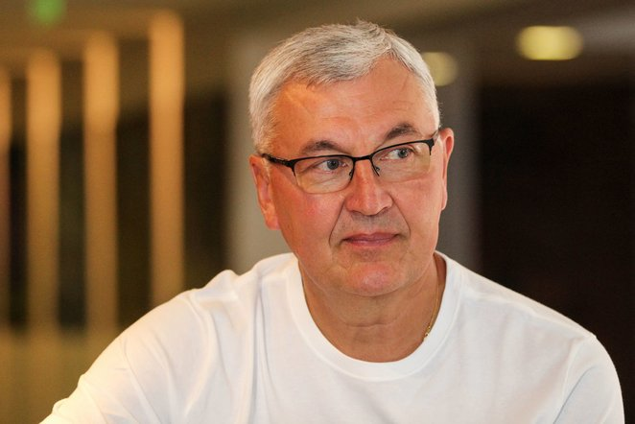
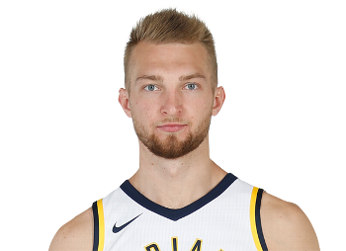
"I can say that another basketball star is growing. His father was uncommon and such human is one per 100 years. I was thinking that if Domantas will not interfere the national team it will be good, but when he actually helps I appreciate it very nicely."
Jonas Kazlauskas, describing Arvydas Sabonis's son Domantas in 2015.

Slide 27
Marijonas Mikutavičius - 3 milijonai. Lithuania – Mexico, FIBA world cup 2014

Slide 28
thank you for watching ☺
the lithuanian team

