Slide 1
Traditional Lithuanian Dishes

Slide 2
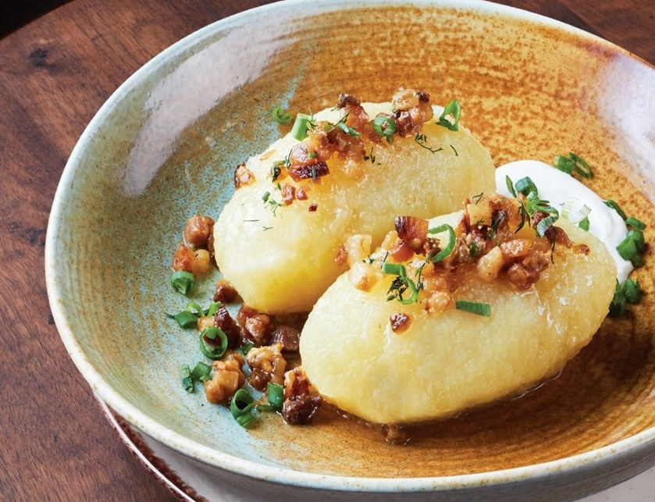
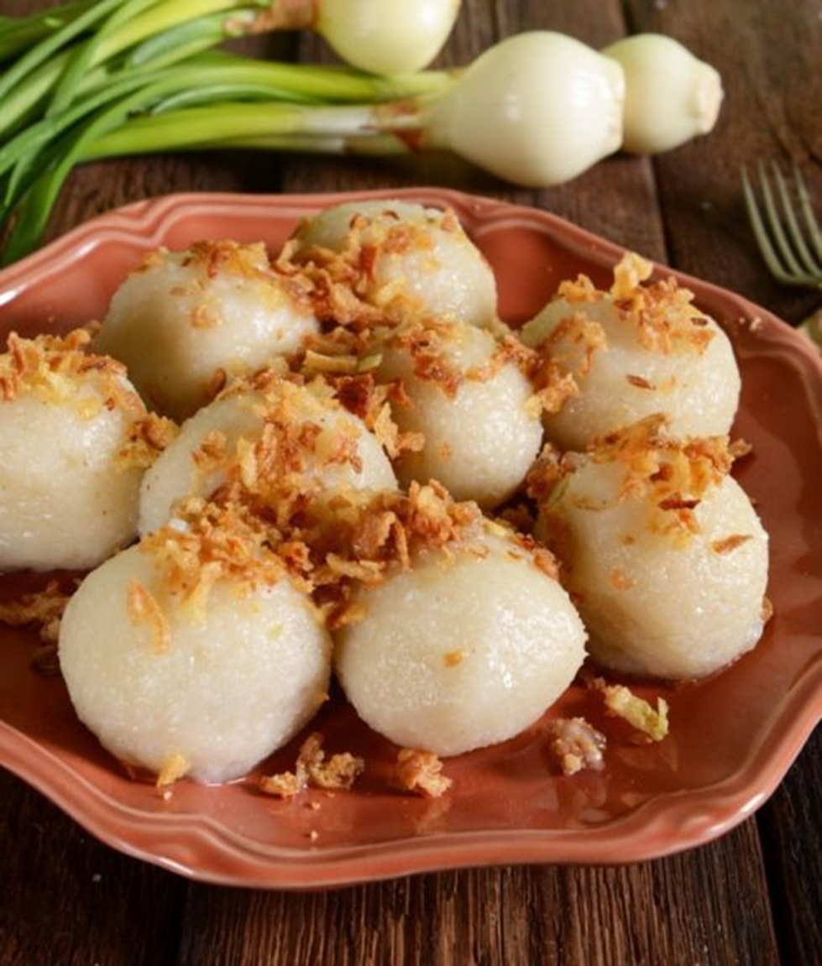
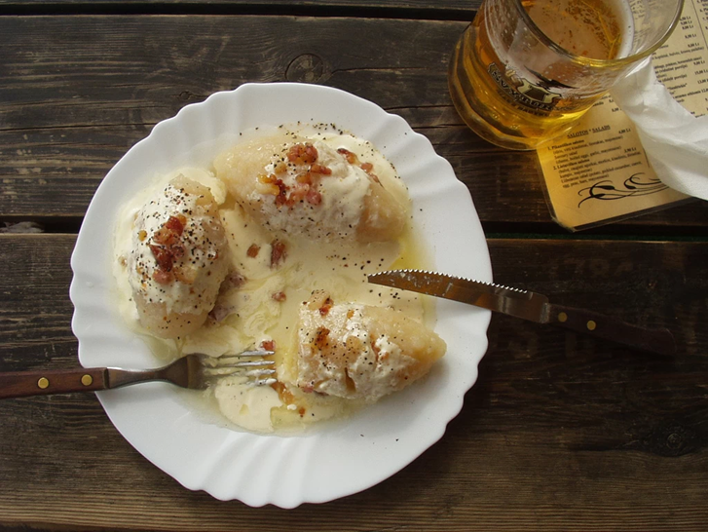
Cepelinai
Starting off with Lithuania’s national dish, the dumplings are made from grated and riced potatoes and stuffed with ground meat or dry curd cheese. It has been described as a national dish of Lithuania, and is typically served as a main dish. After boiling, the cepelinai are often served with sour cream sauce and bacon bits or pork rinds.

Slide 3
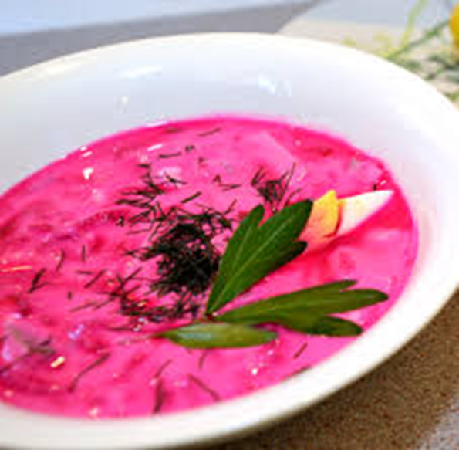
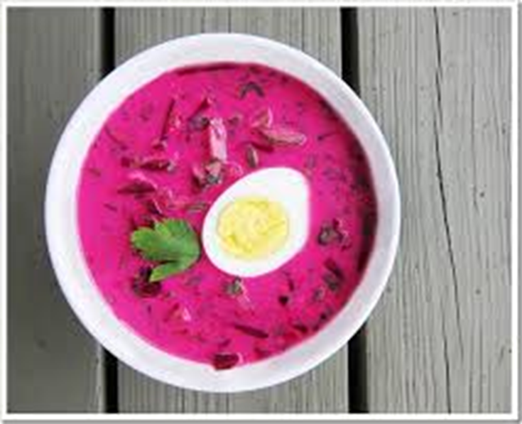
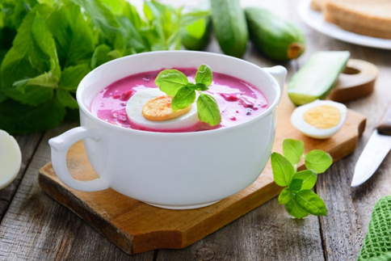
Šaltibarščiai (Chilled Borscht)
Cold borscht is a summer soup based on beets and milk kefir or sour milk. It is made with cooked or pickled beets and other vegetables, such as cucumber, dill, or green onions. Hot boiled potatoes, cold sour cream, and diced hard-boiled eggs are often served alongside to add color, texture. Šaltibarščiai has a shocking color of bright pink. This soup is popular in summer time.

Slide 4
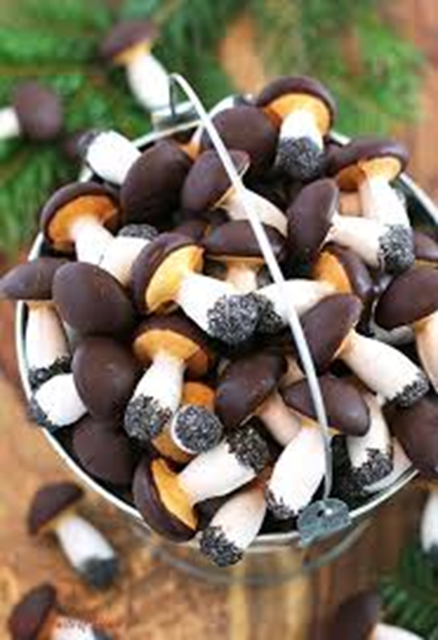
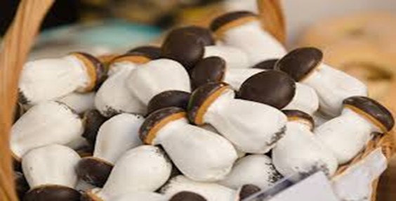
Grybukai (Mushroom Cookies)
These little guys are from true Lithuanian roots of grandmothers. These "Grybukai" are sugar cookies that are frosted with vanilla and chocolate glaze, accompanied by their bottoms dipped in poppy seeds. It is one of our favorite items that we sell in our markets, and give as a presents to kids.

Slide 5
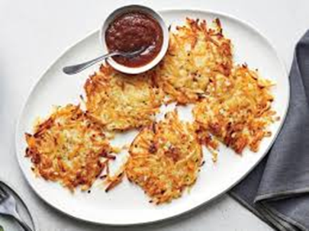
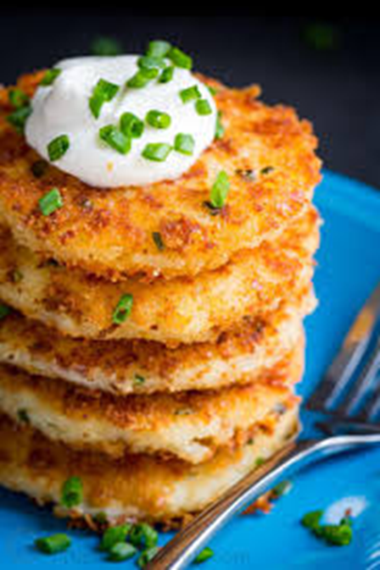
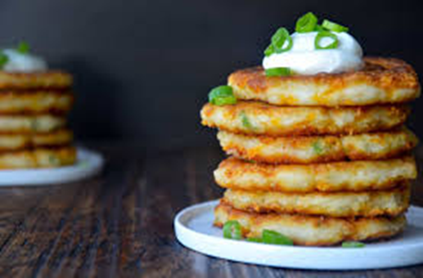
Potato Pancakes
Potatoes are truly king when it comes to Lithuanian food. Potato pancakes are a simple dish to make, comprising grated potatoes, onion, and eggs mixed together and fried in oil. They are served with dill, scallions, and sour cream.

Slide 6
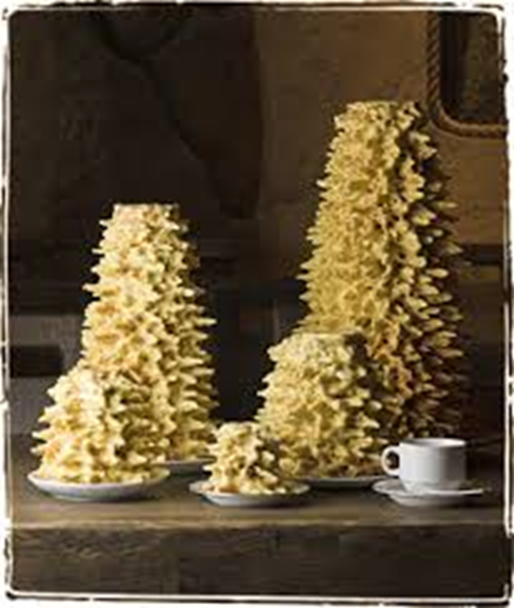
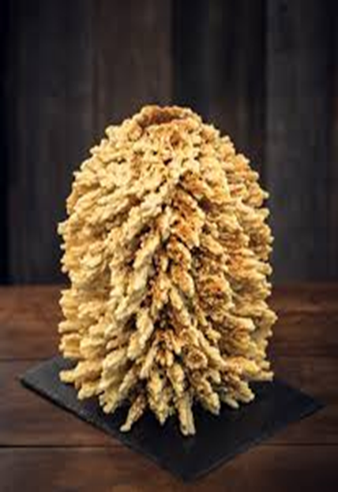
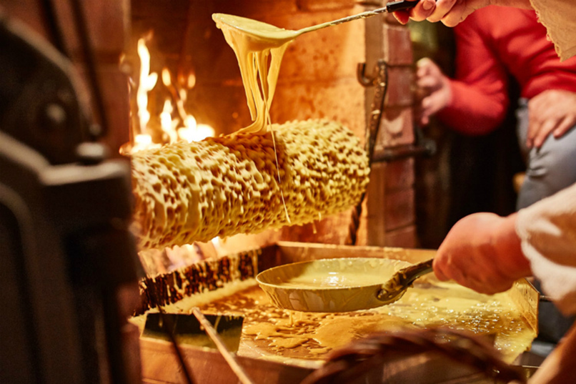
Šakotis
Sakotis, is a traditional Lithuanian cake that is served during special occasions like weddings, Christmas Eve, and Easter. This cake is a large, hollow ring with spines around the edges that are created from dripping batter as the cake is turned around and around on a spit-like cooker.

Slide 7
Thank you for your attention!

